Slide 1
Superfluidity
Giorgi kumsiashvili

Slide 2
Superfluidity
What?
Where?
Why?
a state of matter in which the matter behaves like a fluid with zero viscosity
Astrophysics
High energy Physics
Theories of Quantum Gravity
Super-cooling to near Absolute Zero Temperatures
Bose-Einstein Condensate

Slide 3
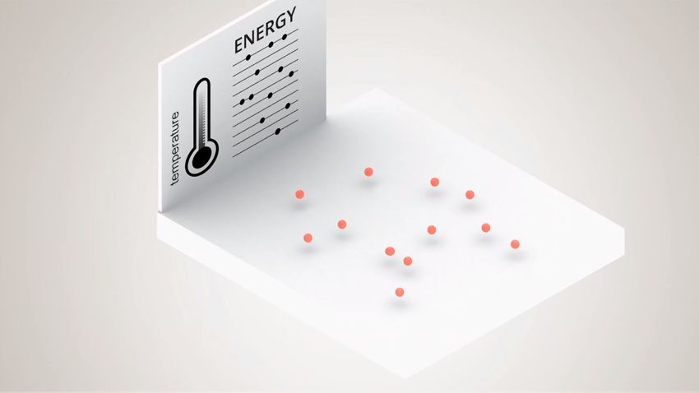
Bose-Einstein Condensate

Slide 4
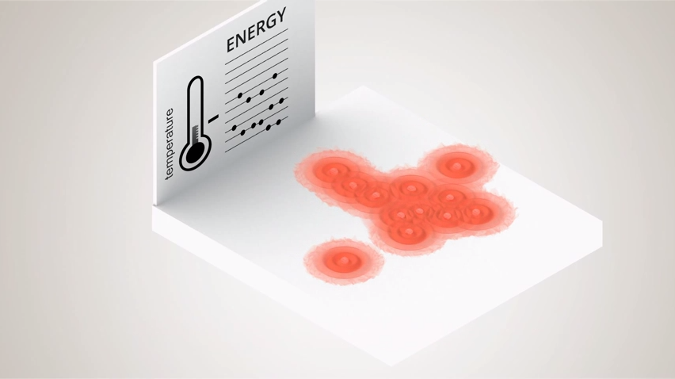
Bose-Einstein Condensate

Slide 5
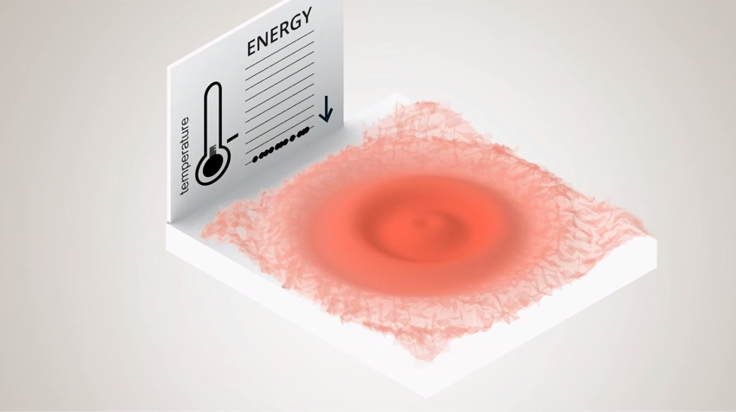
Bose-Einstein Condensate

Slide 6
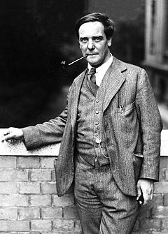
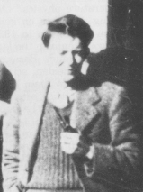
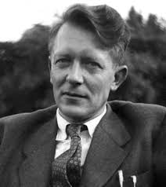
The effect was Discovered in 1937
Pyotr Kapitsa
John F. Allen
Don Misener

Slide 7
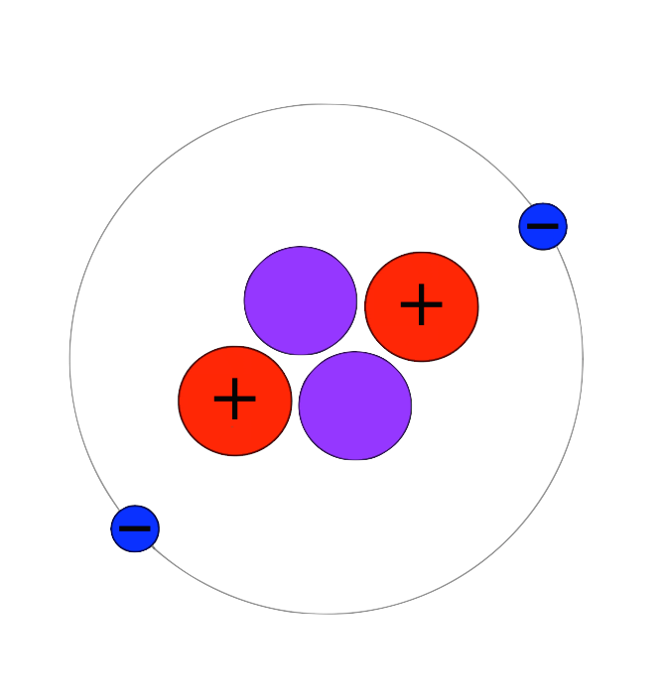
Helium-4
2 Protons
2 Neutrons
2 Electrons
Integer Spin (Thus each H-4 atom being a Boson particle)

Slide 8
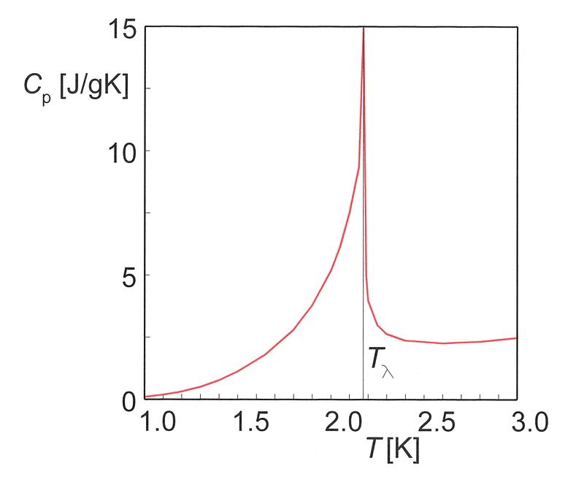
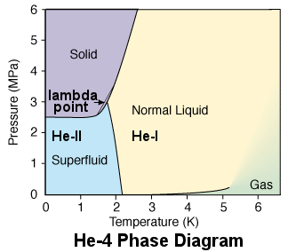
Phase Diagram of H-4

Slide 9
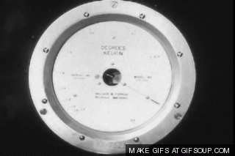
Superfluid Helium-4

Slide 10

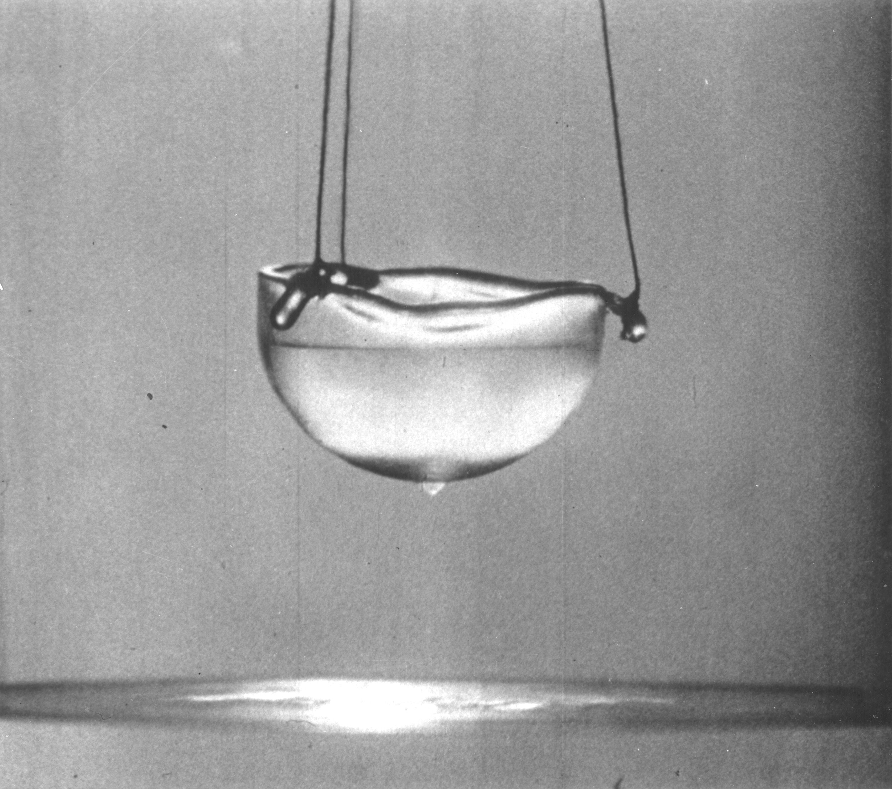
Superfluid Helium-4

Slide 11
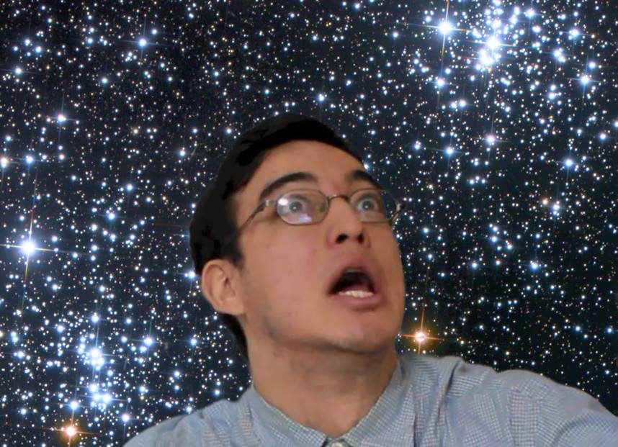
Thanks For Your Attention!!

