Slide 1
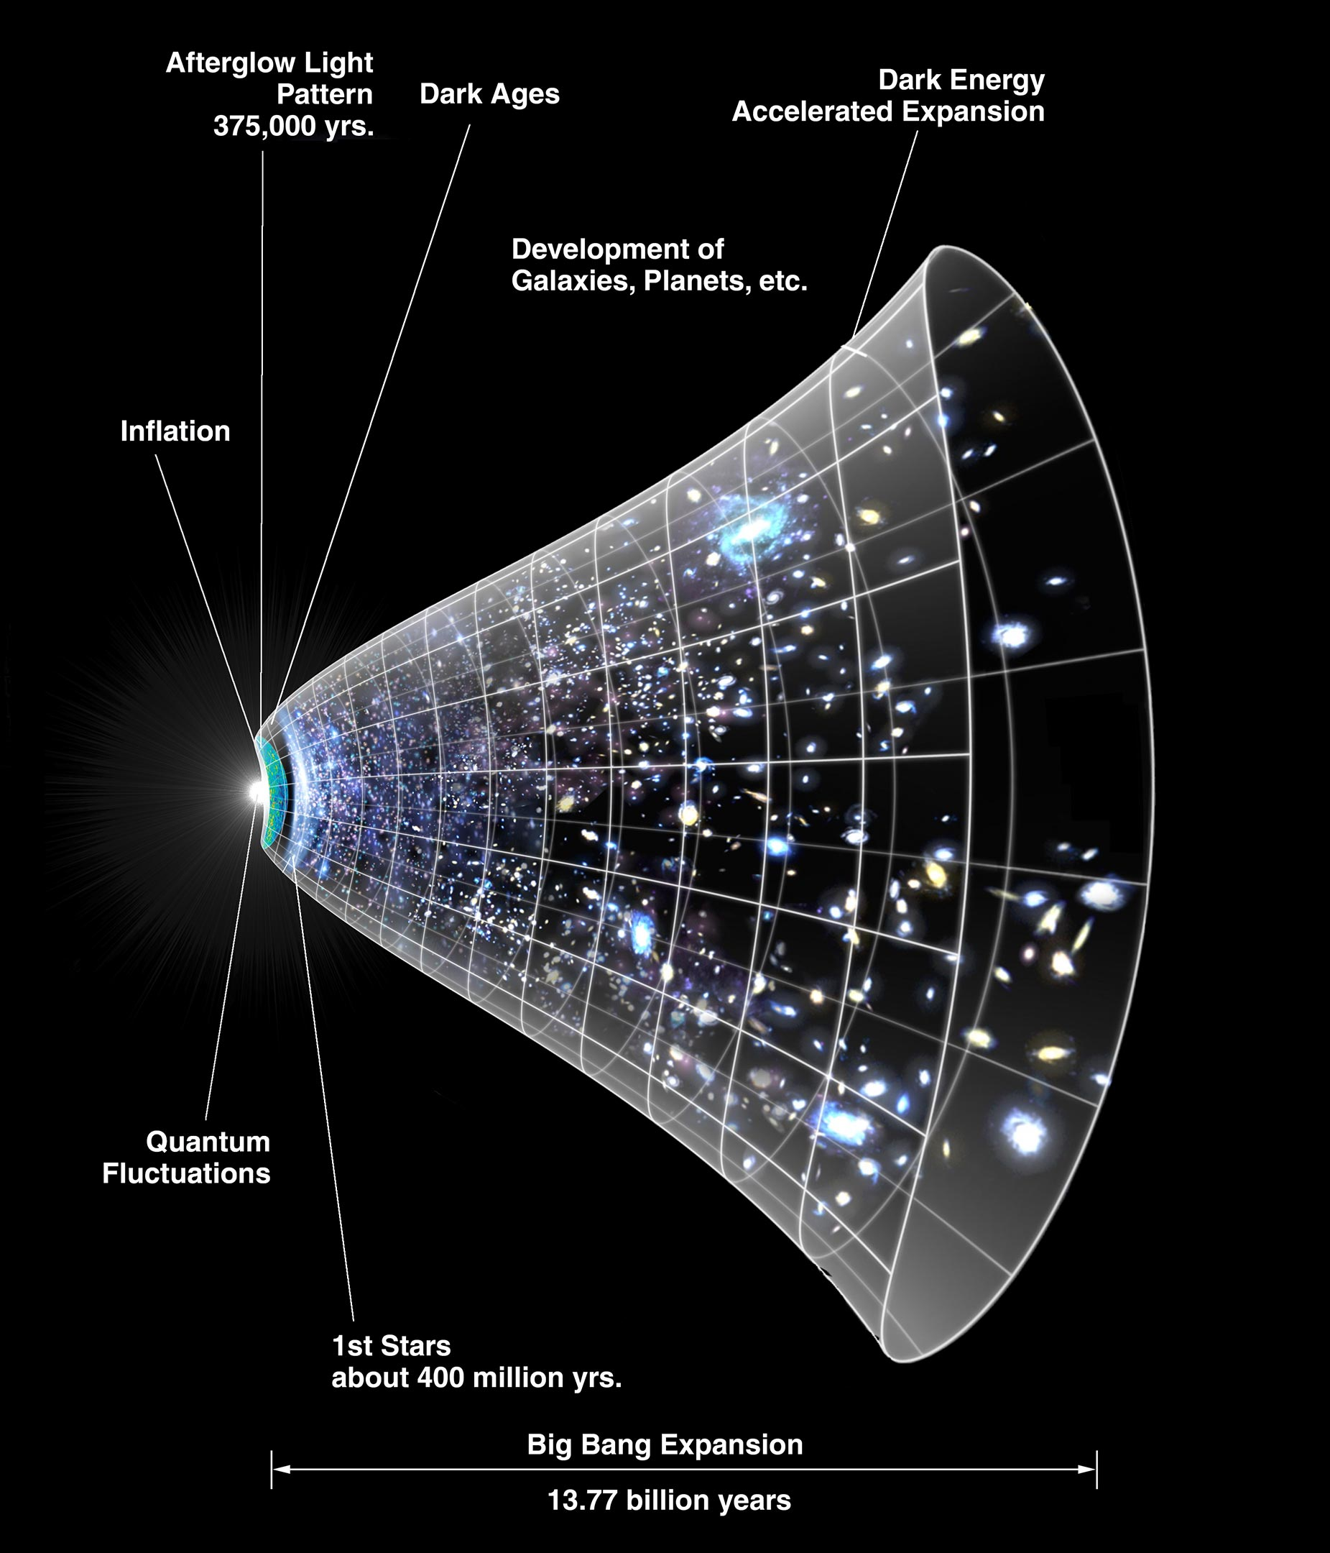
Friedmann Equations and the Expanding Universe
Luka Kopadze

Slide 2
Motivation
Why study this?
  Our universe is expanding — how do we describe that mathematically?
  The Friedmann equations arise from Einstein's equations applied to a homogeneous, isotropic universe.
    Isotropy: The universe looks the same in every direction — its properties do not depend on the direction of observation.
    Homogeneity: The universe looks the same from every location — its properties do not depend on the observer’s position.
Key idea: Apply general relativity to the large-scale structure of the universe.

Slide 3
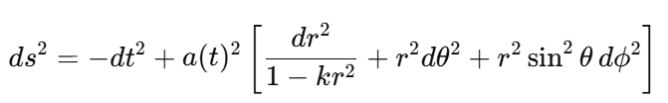
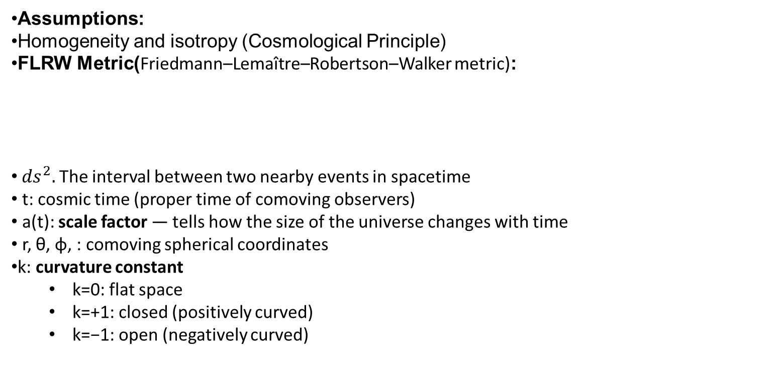
Assumptions & the FLRW Metric
Assumptions:
Homogeneity and isotropy (Cosmological Principle)
FLRW Metric(Friedmann–Lemaître–Robertson–Walker metric):
${ds}^{2}.$ The interval between two nearby events in spacetime
t: cosmic time (proper time of comoving observers)
a(t): scale factor — tells how the size of the universe changes with time
r, θ, ϕ, : comoving spherical coordinates
k: curvature constant
  k=0: flat space
  k=+1: closed (positively curved)
  k=−1: open (negatively curved)

Slide 4

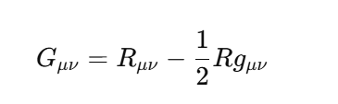

Einstein Field Equations
Field equations:
Use perfect fluid:
​
Plug FLRW metric and perfect fluid into Einstein’s equations → Friedmann equations.

Slide 5
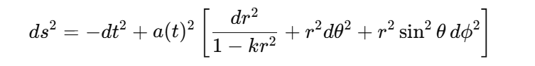
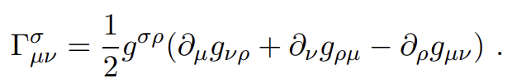





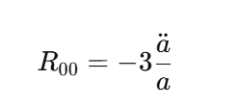
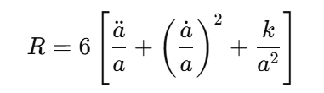
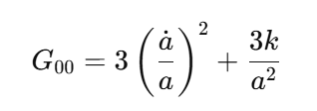


(1)
(2)
(3)
(4)
(5)
(6)
(7)
(8)

Slide 6
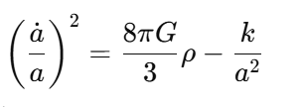
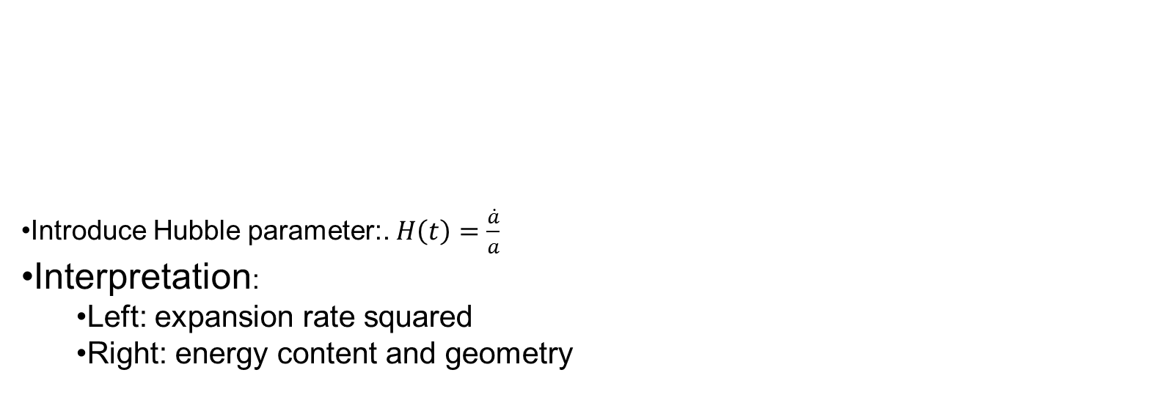
First Friedmann Equation
Introduce Hubble parameter:. $H\left(t\right)=\frac{\dot{a}}{a}$
Interpretation:
  Left: expansion rate squared
  Right: energy content and geometry

Slide 7
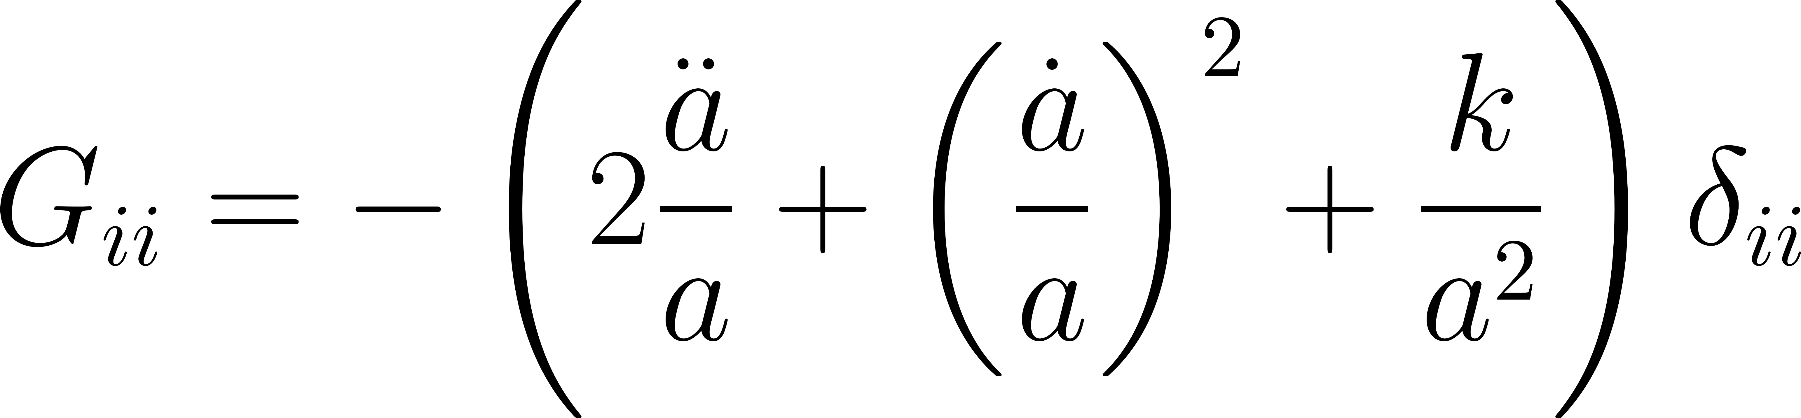
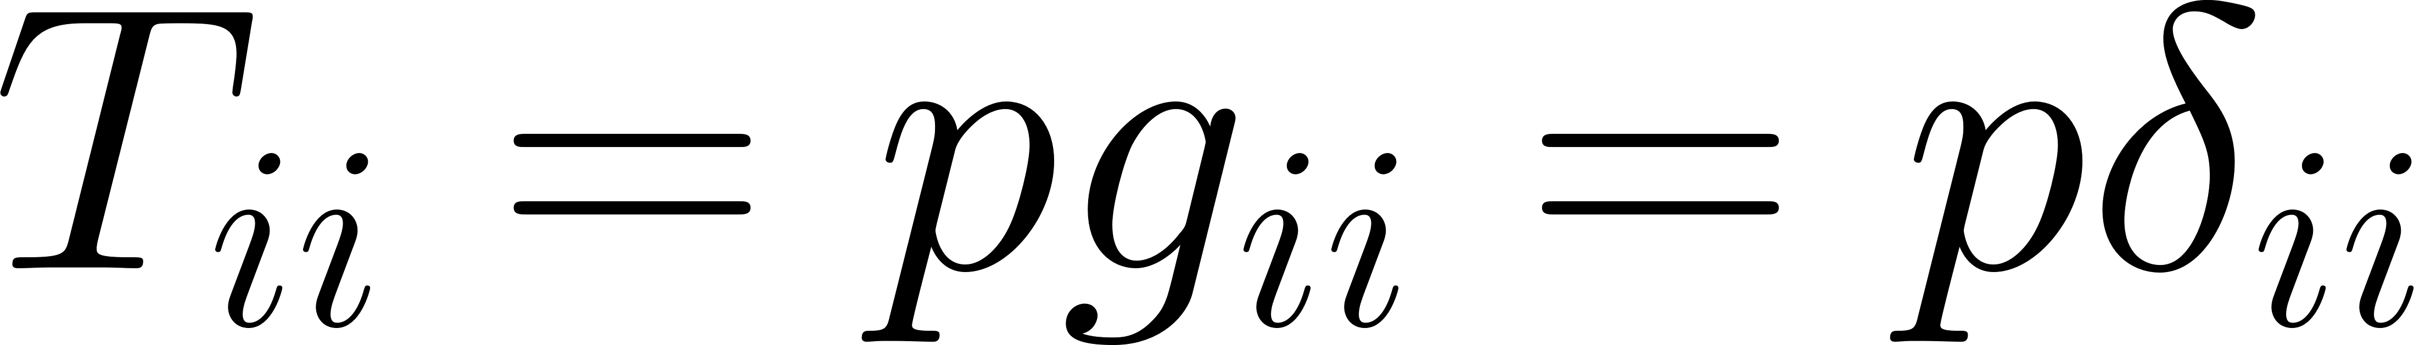
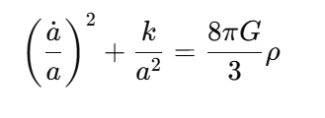
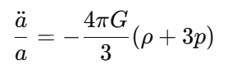
Second Friedmann Equation
Controls the acceleration or deceleration of expansion.
Pressure matters — key insight!
  Radiation: p=ρ/3
  Matter: p≈0
  Dark energy: p<0

Slide 8

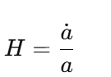
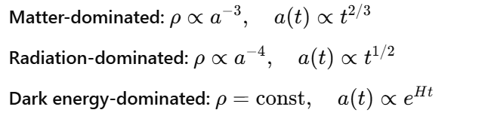


Continuity Equation
Derived from conservation of energy-momentum:
Equivalent to local energy conservation in expanding space.
Age of the universe: $t_{0}$ = 2/3 $H_{0}$
Age of the universe: $t_{0}$ = 1/2 $H_{0}$

Slide 9
Summary & Outlook
Summary:
  Friedmann equations describe the universe's expansion from GR
  Different components (matter, radiation, Λ) affect evolution

Slide 10
Bibliography
მერაბ გოგბერაშვილი, კოსმოლოგია და ელემენტარული ნაწილაკები ,რელატივისტური კოსმოლოგია ,.
Barbara Ryden, Introduction to Cosmology, Cambridge University Press, 2017.
Wikipedia contributors, “Friedmann equations” and “FLRW metric”

Slide 11
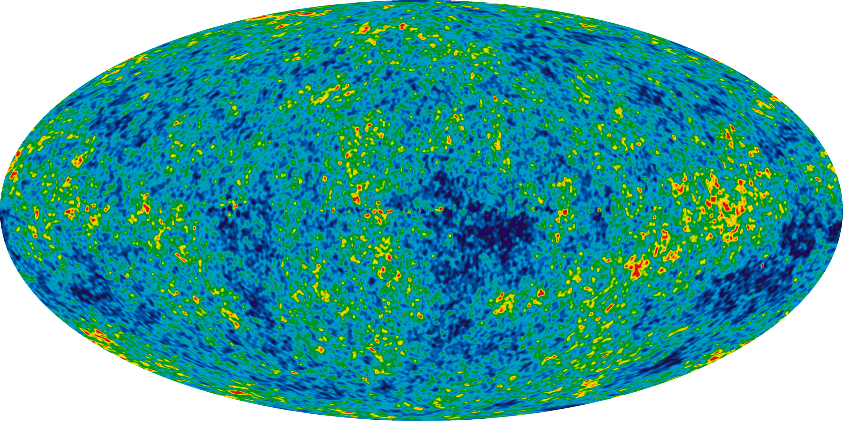
Thank You

