Slide 1

B-violation in Standard Model
Ivane Javakhishvili Tbilisi State University
Elementary Particle Physics (Master’s)
Elementary Particle Physics
Tamar Mamadashvili
Supervisor: Assoc. Prof. Merab Gogberashvili

Slide 2
Antimatter
Baryon asymmetry of the Universe (BAU)
Sakharov conditions
Sakharov conditions in Standard Model
B-violation in Standard Model and goals

Slide 3
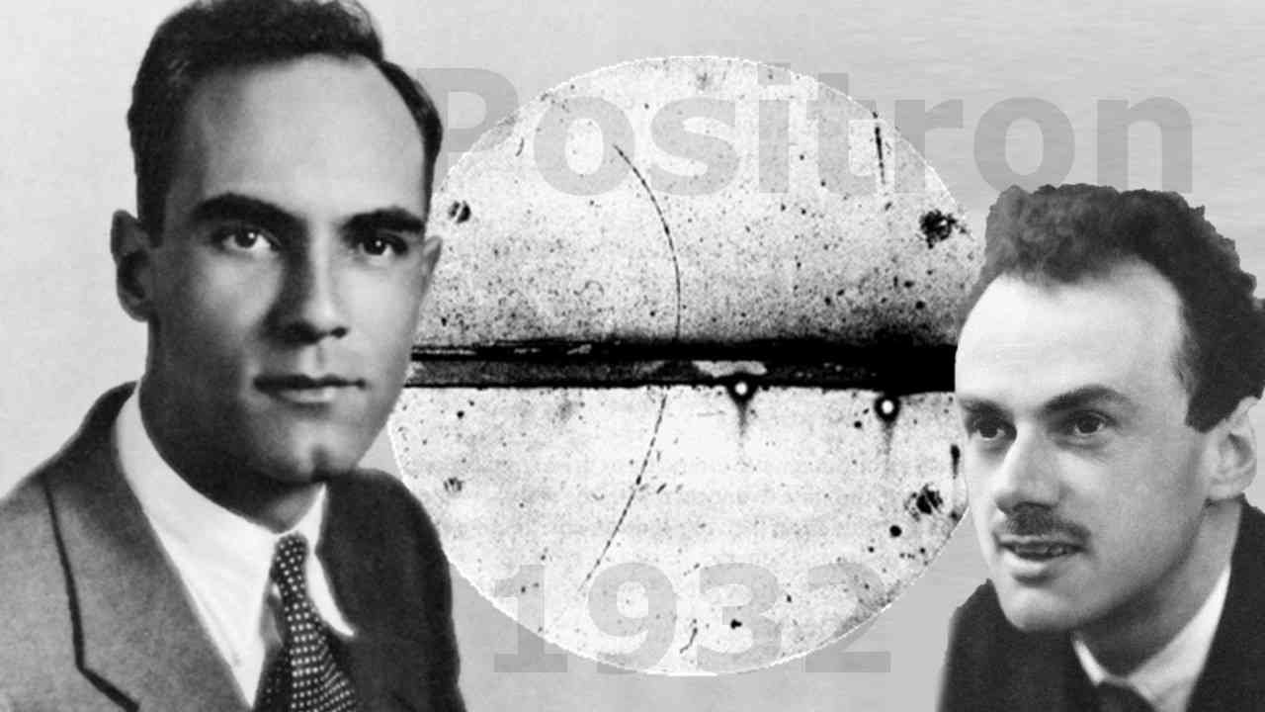
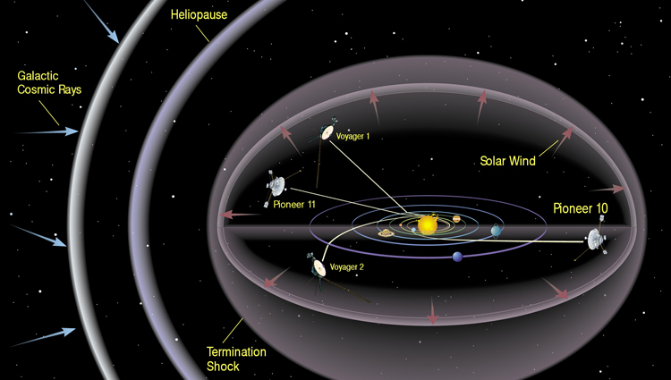
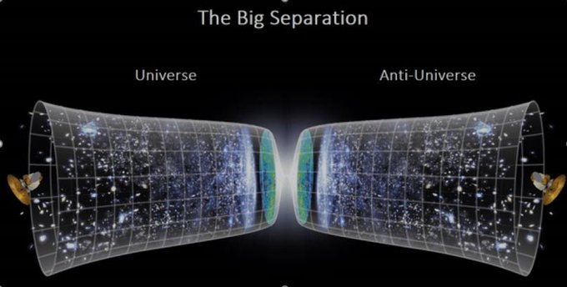

Antimatter
Anderson & Dirac
In cosmic rays:
$$\frac{\overline{p}}{p}\sim {10}^{−4}$$
Annihilation processes?
Enough antimatter in cosmic rays?
Antiuniverse?

Slide 4
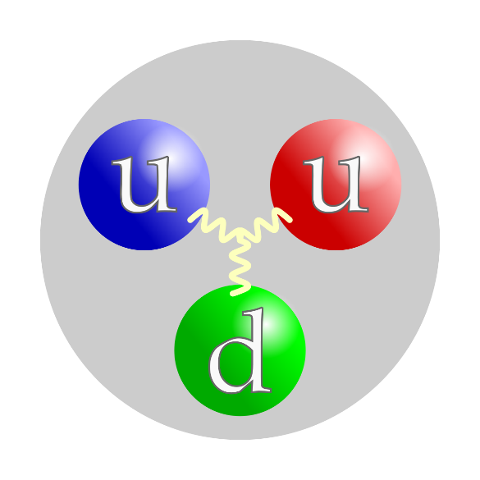
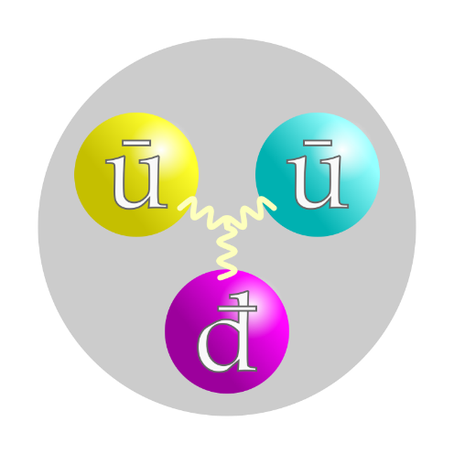
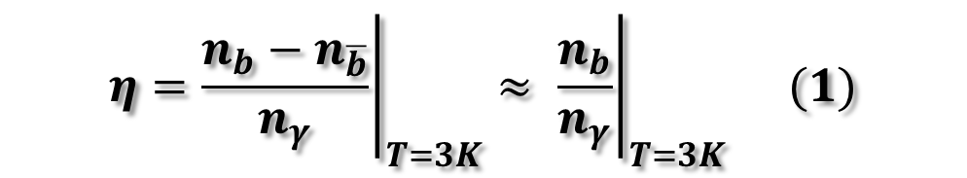

Baryon asymmetry of the Universe (BAU)
$$η={\left.\frac{n_{b}−n_{\overline{b}}}{n_{γ}}\right|}_{T=3K}≈ {\left.\frac{n_{b}}{n_{γ}}\right|}_{T=3K} (1)$$
$$η=\frac{n_{B}}{n_{γ}}\sim {10}^{−10}$$
(2)
by WMAP experiment
The production of matter excess $→$ baryogenesis

Slide 5
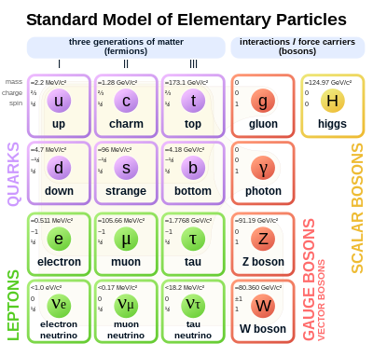

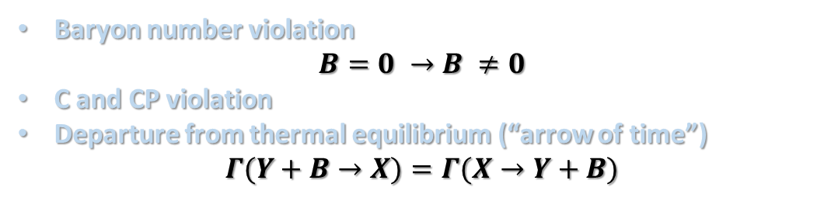
Sakharov conditions
Baryon number violation
$B=0 →B ≠0$
C and CP violation
Departure from thermal equilibrium (“arrow of time”)
$Γ(Y+B→X)=Γ(X→Y+B)$
Sakharov conditions
in Standard Model
Sphaleron processes
Weak interactions
Expansion of the universe

Slide 6
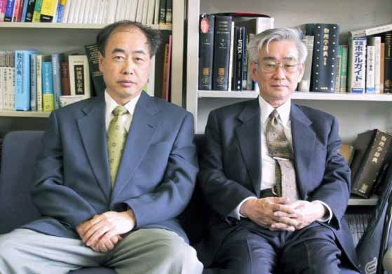
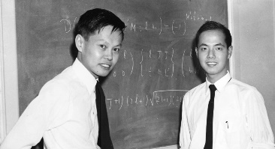

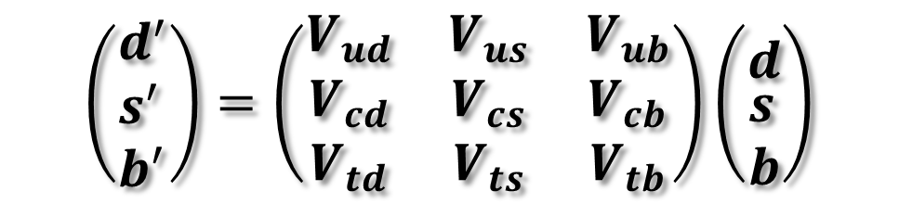



Sakharov conditions in SM
Kobayashi & Maskawa
Electroweak theory:
Thermal non-equillibrium
B-number violation
C and CP violations
CP violation in standard
electroweak theory:
$C : q_{L}→\overline{q_{L}}$.
CKM matrix ($V_{CKM}{V_{CKM}}^{+}=1$ )
$$CP : q_{L}→\overline{q_{R}}$$
T.D Lee & C.N. Yang
$$\left(\begin{aligned}&d^{′} \\ &s^{′} \\ &b^{′}\end{aligned}\right)=\left(\begin{matrix}V_{ud} & V_{us} & V_{ub} \\ V_{cd} & V_{cs} & V_{cb} \\ V_{td} & V_{ts} & V_{tb}\end{matrix}\right)\left({d \atop \begin{aligned}&s \\ &b\end{aligned}}\right)$$
CP violating strength $\sim {10}^{−20}$

Slide 7
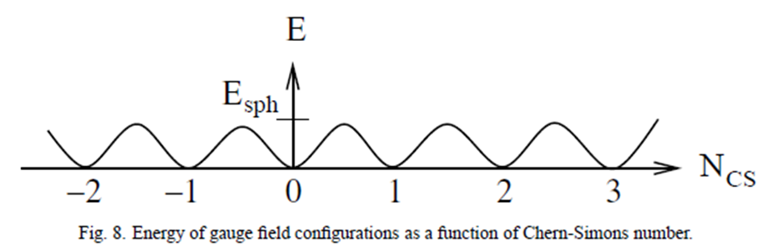

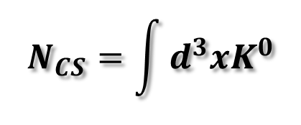

Sakharov conditions in SM
Baryon number violation
$$N_{CS}=\int{d^{3}xK^{0}}$$
$where K^{μ}=\frac{g^{2}}{32π^{2}}ε^{μναβ}{\left(F\right.}_{να}^{a}A_{β}^{a}−\frac{g}{3}ε_{abc}A_{ν}^{a}A_{α}^{b}A_{β}^{c}$)
$$A\sim {10}^{−173}$$
Tunneling amplitude:
[1]
Energy of gauge field configurations as a function of Chern-Simons number
[1] Gerard ‘t Hooft. Symmetry breaking through Bell-Jackiw Anomalies (Phys. Rev. 1976)

Slide 8
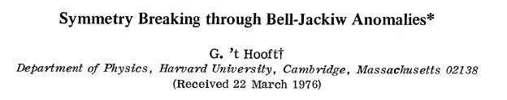
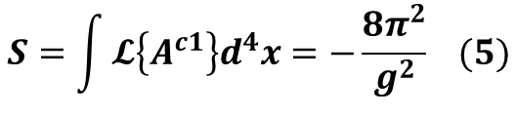
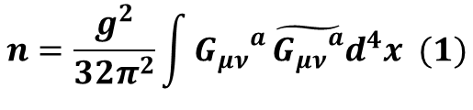




The Bell-Jackiw anomaly
The solution of classical 4D Euclidean gauge-field theories is obtained from the vacuum by mapping SU(2) gauge transformations onto a large sphere in Euclidean space
Taking the new, gauge-rotated vacuum, we obtain a nontrivial solution inside the sphere, characterized by a topological quantum number:
$$n=\frac{g^{2}}{32π^{2}}\int{{G_{μν}}^{a}}\tilde{{G_{μν}}^{a}}d^{4}x (1)$$
Lagrangian is:
$𝓛^{YM}=−\frac{1}{4}{G_{μν}}^{a}{G_{μν}}^{a}$, a=1,2,3 (2)
${G_{μν}}^{a}$=$∂_{μ}A_{ν}^{a}−∂_{ν}A_{μ}^{a}+gε_{abc}A_{μ}^{b}A_{ν}^{c}$,
$\tilde{{G_{μν}}^{a}}=\frac{1}{2}ε_{μναβ}G_{αβ}^{a}$ (3)
These solutions are relevant for describing a tunneling mechanism in real space-time, from one vacuum state to a gauge-rotated vacuum
$$A_{μ}^{a}{\left(x\right)}^{c1}=\frac{2}{g}\frac{η_{aμν}{\left(x−x_{0}\right)}^{ν}}{{\left(x−x_{0}\right)}^{2}+λ^{2}} (4)$$
The solution with n=1 in Euclidean space is:
$$S=\int{𝓛\left\{A^{c1}\right\}d^{4}x=−\frac{8π^{2}}{g^{2}} (5)}$$
The solution has:

Slide 9

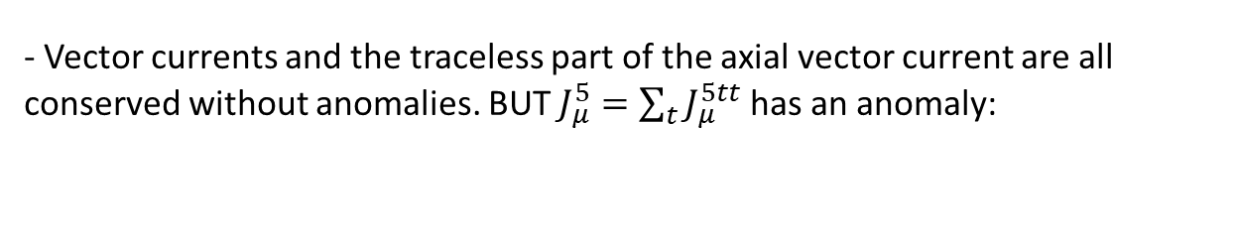
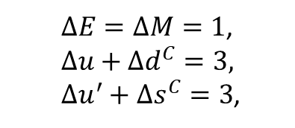
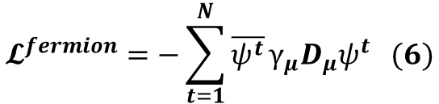



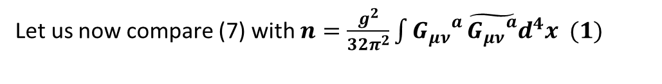
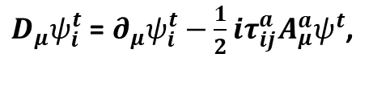

Now in addition N massless fermion doublets coupled to the gauge field:
$$𝓛^{fermion}=−\sum_{t=1}^{N}{\overline{ψ^{t}}}γ_{μ}D_{μ}ψ^{t} (6)$$
$D_{μ}ψ_{i}^{t} \text{=} ∂_{μ}ψ_{i}^{t}−\frac{1}{2}iτ_{ij}^{a}A_{μ}^{a}ψ^{t}$,
$$index i=\text{color}, t=1,…N "flavor"$$
$$J_{μ}^{st}=i\overline{ψ^{s}}{γ_{μ}ψ}^{t},$$
$$J_{μ}^{5st}=i\overline{ψ^{s}}{γ_{μ}γ_{5}ψ}^{t}$$
- Vector currents and the traceless part of the axial vector current are all conserved without anomalies. BUT $J_{μ}^{5}=\sum_{t}{J_{μ}^{5tt}}$ has an anomaly:
$∂_{μ}J_{μ}^{5}=−\frac{iNg^{2}}{16π^{2}}{G_{μν}}^{a}\tilde{{G_{μν}}^{a}}$ (7)
Let us now compare (7) with $n=\frac{g^{2}}{32π^{2}}\int{{G_{μν}}^{a}}\tilde{{G_{μν}}^{a}}d^{4}x (1)$
n=1 configuration in Minkowski space would be associated with a violation of axial charge conservation: $∆Q^{5}=2N$
Application: Weinberg-Salam $SU\left(2\right)⨂U\left(1\right)$model: Baryon and lepton currents have anomalies. One Euclidean-gauge soliton gives:
$∆E=∆M=1$,
$$∆u+∆d^{C}=3,$$
$∆u^{′}+∆s^{C}=3$,
Thus, because of the Cabibbo rotation, a proton and a neutron may annihilate to form two antileptons, one of electron and one of muon type.

Slide 10
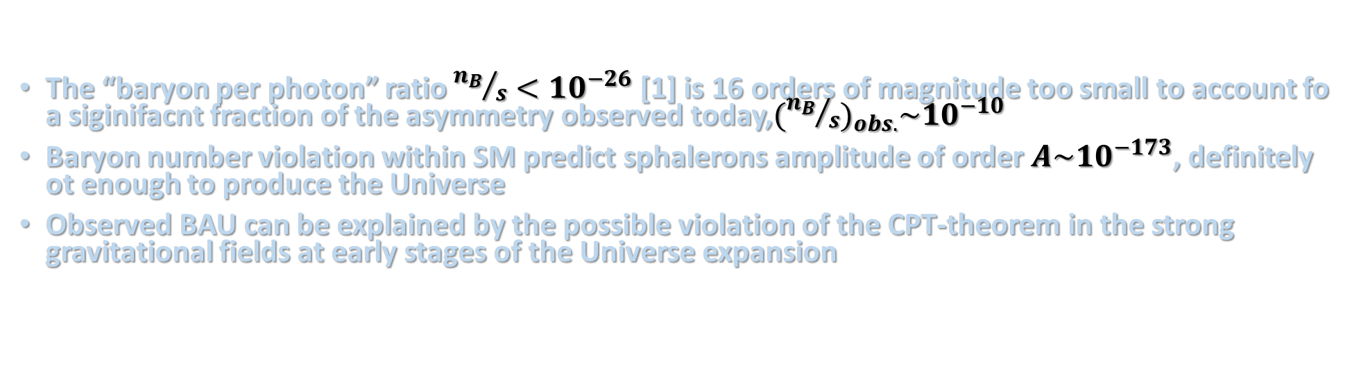
Conclusion:
Baryogenesis is very unlike to be achieved within SM:
The “baryon per photon” ratio ${n_{B}}/s<{10}^{−26}$ [1] is 16 orders of magnitude too small to account fo a siginifacnt fraction of the asymmetry observed today,${({n_{B}}/s)}_{obs.}\sim {10}^{−10}$
Baryon number violation within SM predict sphalerons amplitude of order $A\sim {10}^{−173}$, definitely ot enough to produce the Universe
Observed BAU can be explained by the possible violation of the CPT-theorem in the strong gravitational fields at early stages of the Universe expansion
Goals:
Show the Baryon number violation value in Standard Model
Add gravitational effects, i.e. see B-violation in curvilinear spaces
Energy of gauge field configurations as a function of Chern-Simons number
[1] P. Huet, E. Sather, Electroweak Baryogenesis and the Standard Model CP Violation (arXiv, 1994)

Slide 11
Literature:
[1]. Andro Barnaveli, Merab Gogberashvili. BARYON AND TIME ASYMMETRIES OF THE UNIVERSE (arXiv, 1995)
[2]. James M. Cline. BARYOGENESIS (arXiv, 2006)
[3]. Eric Sather. The mystery of the matter asymmetry (SLAC Beam Line 26N1, 1996)
[4]. L. Canetti, M. Drewes, M. Shaposhnikov. Matter and Antimatter in the Universe (arXiv, 2012)
[5]. C.S. Wu, E. Ambler, R.W. Hayward, D. D. Hoppess, R. P. Hudson. Experimental Test of Parity Conservation in Beta Decay (PhysRev., 1957)
[6]. Aliaksei Kachanovich. Electroweak baryogenesis (KIT, 2019)
[7]. Patrick Huet. Electroweak Baryogenesis and the Standard Model (arXiv, 1994)
[8]. G. ‘t Hooft. Symmetry Breaking through Bell-Jackiw Anomalies (Phys. Rev., 1976)

Slide 12
Thank you for your attention!

