Slide 1
De Sitter Space

Slide 2
contents
What is de Sitter Space?
Why de Sitter Space?
different coordinate systems
Some Penrose diagrams and its interpretation

Slide 3
What is de Sitter Space?
The de Sitter universe is the second model of the universe just after the publications of the Einstein’s static and closed model. In 1917, Wilhelm de Sitter has developed this model which is a maximally symmetric solution of the Einstein field equation with zero density.
It models the universe as spatially flat and neglects ordinary matter, so the dynamics of the universe are dominated by the cosmological constant

Slide 4
Why de Sitter Space?
The de Sitter model of the universe was an exciting, because he discussed the relation between gravity and inertia, and also on Ernst Mach’s hypothesis that the inertia of one body is caused by the presence of all others.
The equations of motion for the scale factor of the universe derived from Einstein’s theory of gravity always required the size of our universe to be dynamically changing. Einstein was very uncomfortable with the motion of a dynamic universe as at that time no evidence indicated an expanding or contracting universe .

Slide 5
Why de Sitter Space?
Because our Universe entered the Dark Energy Dominated Era about five billion years ago, our universe is probably approaching a de Sitter universe in the infinite future. If the current acceleration of our universe is due to a cosmological constant then as the universe continues to expand all of the matter and radiation will be diluted. Eventually there will be almost nothing left but the vacuum energy, tiny thermal fluctuations, quantum fluctuations and our universe will have become a de Sitter universe.
the effect on curvature from it will approach zero, and the cosmological constant effect will be virtually the whole show. One says our universe is asymptotically de Sitter.

Slide 6
Relative expansion
The exponential expansion of the scale factor means that the physical distance between any two non-accelerating observers will eventually be growing faster than the speed of light. At this point those two observers will no longer be able to make contact. Therefore, any observer in a de Sitter universe would see event horizons beyond which that observer can never see nor learn any information. If our universe is approaching a de Sitter universe then eventually we will not be able to observe any galaxies other than our own Milky Way

Slide 7
Why de Sitter Space?
In relativistic cosmology the de Sitter universe is perhaps the simplest model that allows for the possibility of a galactic redshift. It is curved but homogeneous and isotropic in space-time (Inomata 1968). The expanding half of de Sitter space-time is approximately the exponentially expanding universe in the inflationary model and our universe may be approaching the de Sitter space-time asymptotically. Hence, de Sitter space-time can be a model for our universe in its early expanding phase, and in its far future (Hawking and Ellis 1973).

Slide 8
Why de Sitter Space?
Another application of de Sitter space is in the early universe during cosmic inflation. Many inflationary models are approximately de Sitter space and can be modelled by giving the Hubble parameter a mild time dependence. For simplicity, some calculations involving inflation in the early universe can be performed in de Sitter space rather than a more realistic inflationary universe. By using the de Sitter universe instead, where the expansion is truly exponential, there are many simplifications.

Slide 9
Geometrical viewpoint
From the geometrical viewpoint, among the cousins of Minkowski spacetime (the class of Lorentzian manifolds) de Sitter and anti-de Sitter spacetimes are its closest relatives. Indeed, like the Minkowski spacetime, they are maximally symmetric, i.e. they admit kinematical symmetry groups having ten generators . Maximal symmetry also implies that the curvature is constant (zero in the Minkowski case). The de Sitter space-time universe has the topology (1 ,3) R × S where, 1 R represents time and 3 S represents 3-dimensional space.
four dimensional Riemannian manifold has an isometry group with at most ten generators. In the Minkowski case the isometry group is the Poincar´e group and the ten independent transformations have a familiar physical interpretation: one time translation, three spatial translations, three rotations and three boosts.

Slide 10
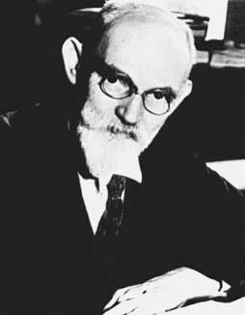
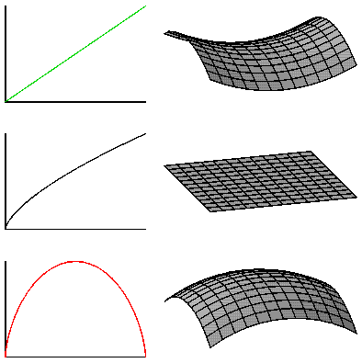
What is de Sitter Space?
1) Λ<0
anti-de Sitter
2) Λ=0
Minkowski
3) Λ>0
de Sitter
(Willem de Sitter,1872-1934)

Slide 11
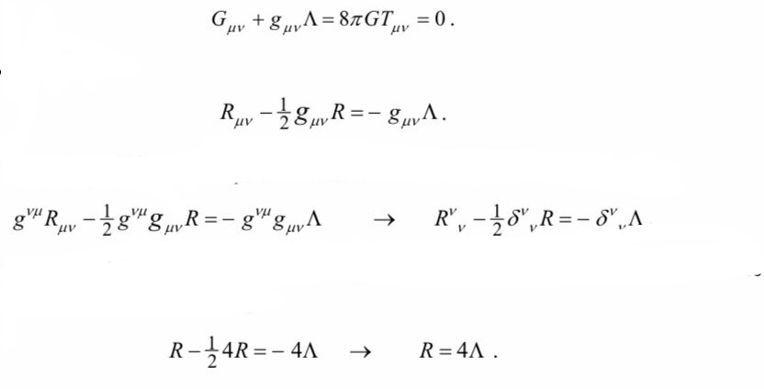
.
Curvature of Spacetime by the Cosmological Constant
Note curvature is positive, and it is constant (at all points in 4D space and time). Thus, a positive cosmological constant (with no mass-energy) means spacetime has positive curvature, and that curvature is the same everywhere, at all times.

Slide 12
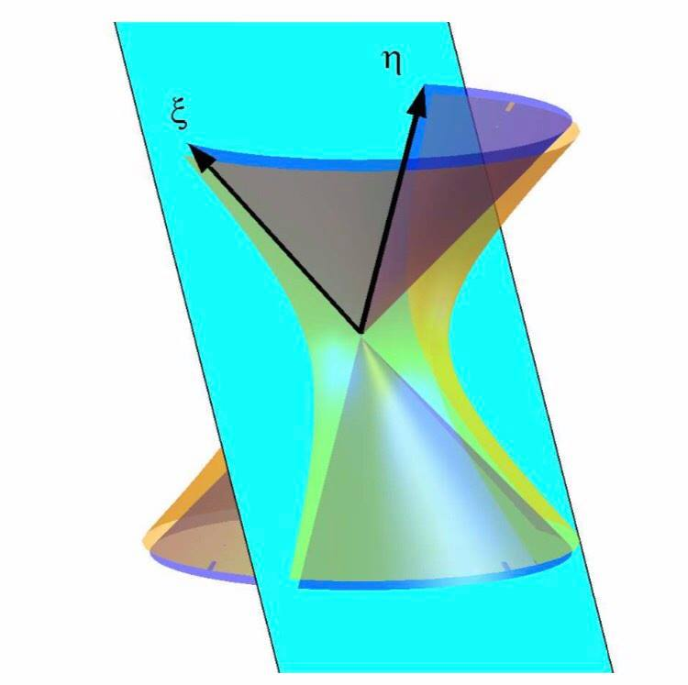
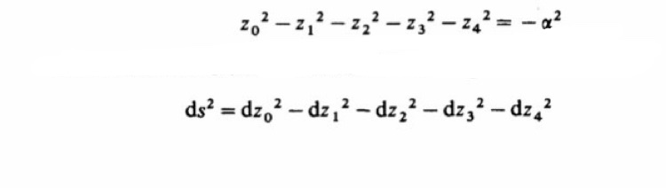
A four dimensional de Sitter space is a hyperboloid embedded in a five dimensional Minkowski space!

Slide 13
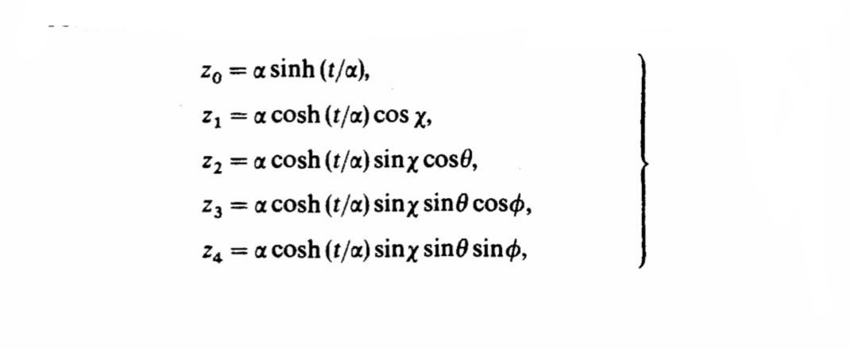
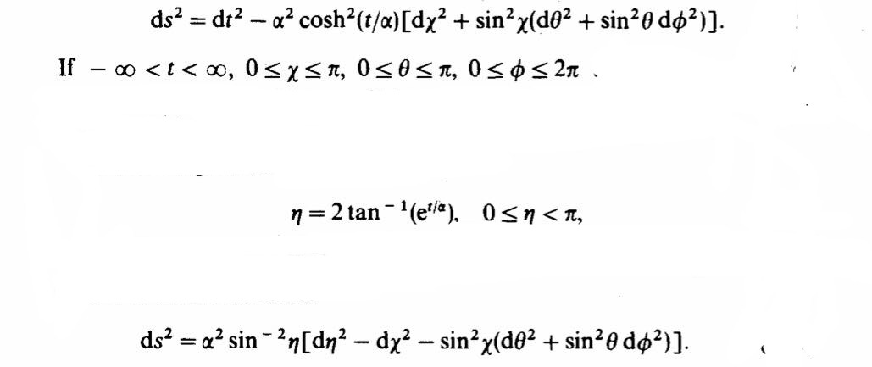
The global coordinates

Slide 14
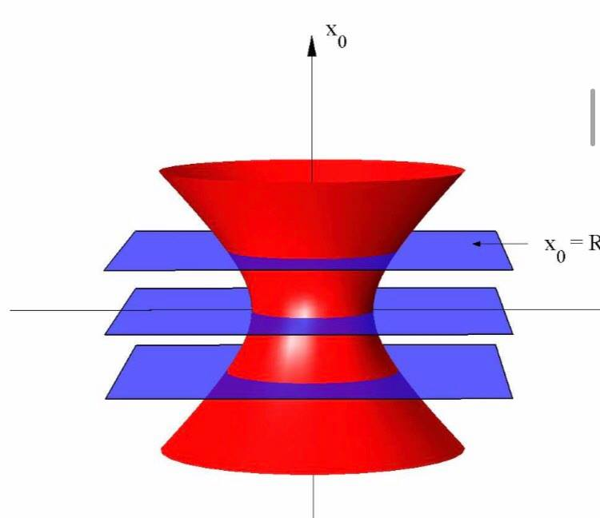
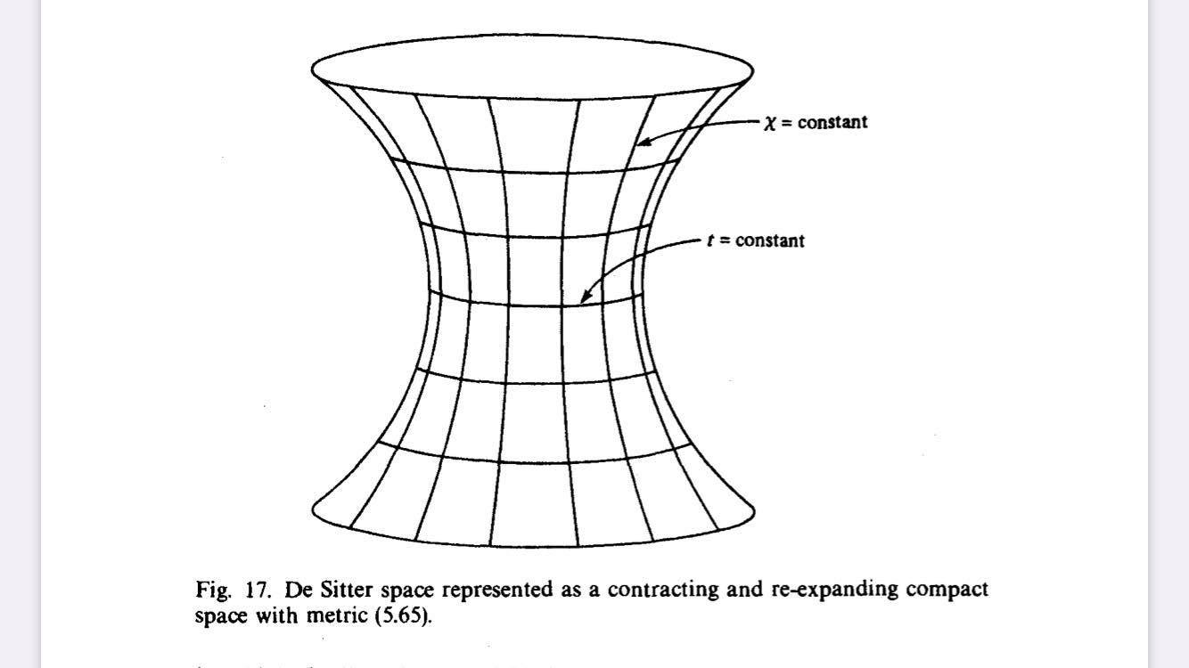
The global coordinates

Slide 15
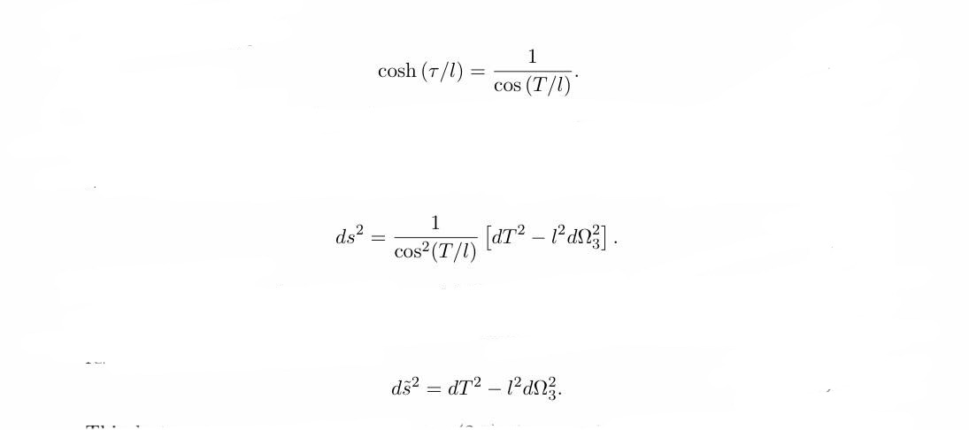
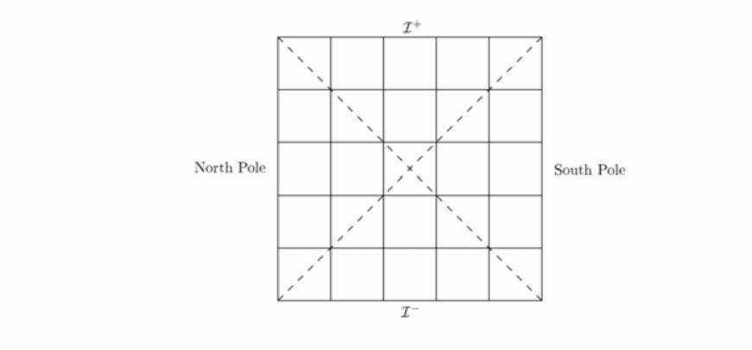
Penrose diagram/covers full manifold

Slide 16
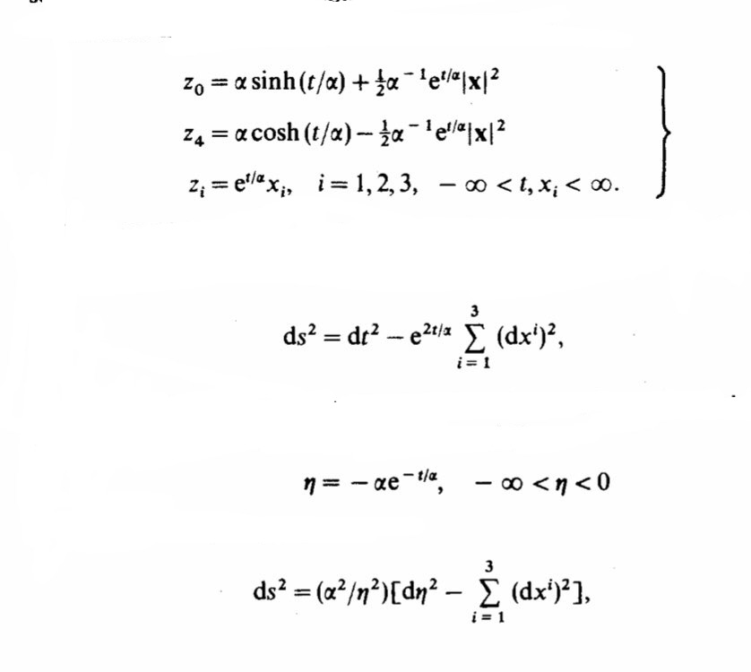
Consider first the coordinates (t, x) defined by planar coordinates
which cover the half of the de Sitter manifold
Where is defined conformal time
Line element becomes

Slide 17
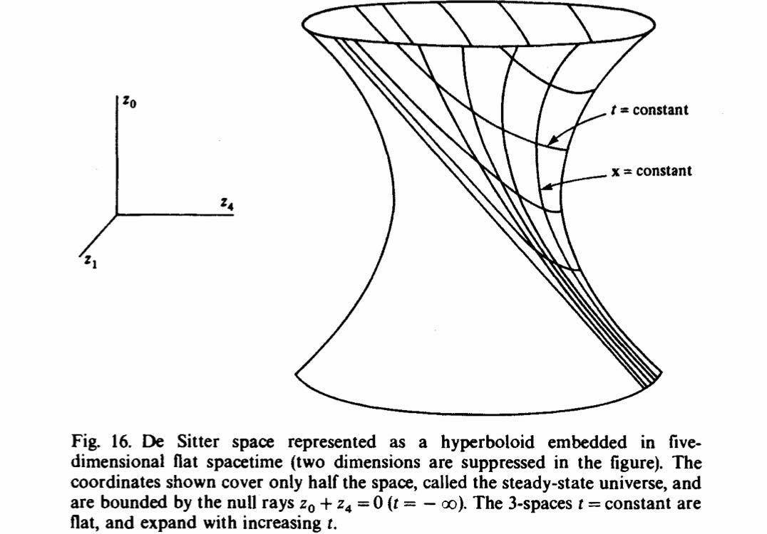
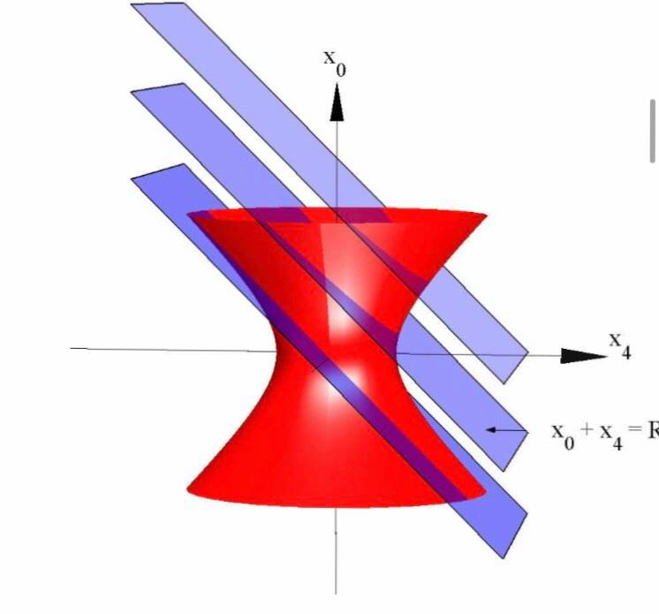

Slide 18
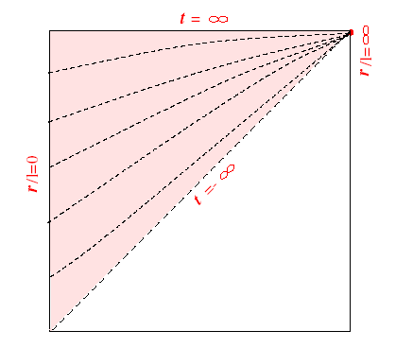
The Penrose Diagram of de Sitter Space in the Planar Coordinates

Slide 19
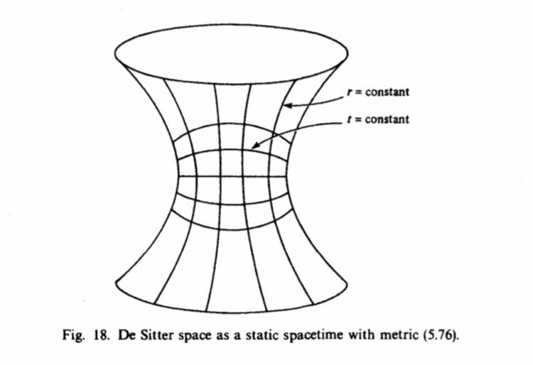
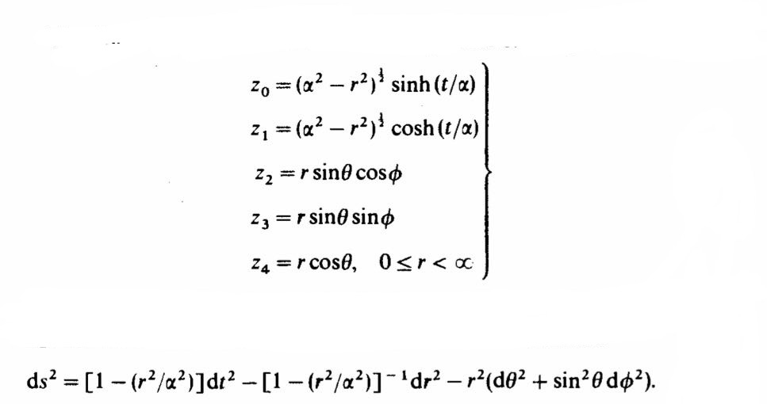
Static coordinates

Slide 20
Thank you!

