Slide 1
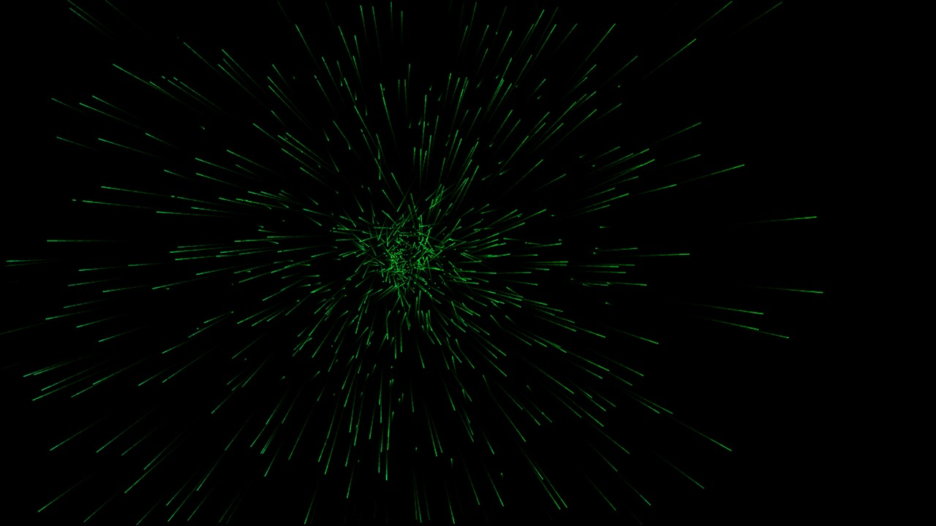

Cosmo particles physics
Department of Physics, Faculty of Exact and Natural Sciences, Tbilisi State University, Tbilisi, Georgia
Teo gotsiridze

Slide 2
Contents:
Cosmic Rays
Review
Sources
High energy CR problems
Air shower
Detectors
Cosmic Neutrinos
Review
Oscillations
Detectors

Slide 3
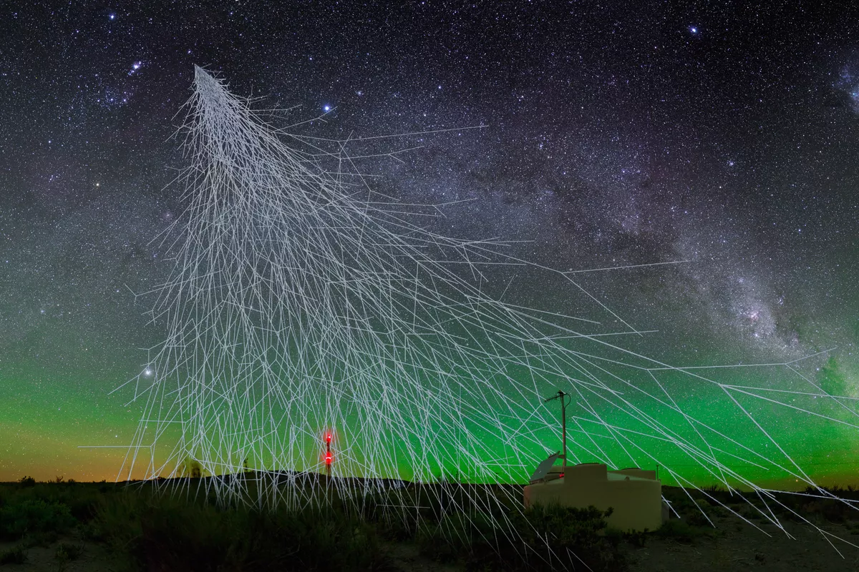
Cosmic rays:
Cosmic rays are called the flow of particles falling from the cosmos to the earth. Galactic and intergalactic magnetic fields traverse the trajectories of cosmic rays, so they do not indicate the location of their radiating source.
This stream consists mainly of
90% - protons (hydrogen nuclei)
9% - alpha particles(helium nuclei)
1% -the nuclei of heavier elements
Cosmic rays can be divided into two types:
Galactic cosmic rays (GCR) - high-energy particles (predominantly protons) emitted by the sun
extragalactic cosmic rays – solar energetic particles -high-energy particles that flow into the Solar system from beyond the Milky Way galaxy. The energies these particles possess are in excess of 10¹⁵ ev.

Slide 4
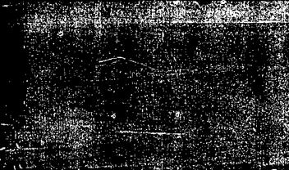
Sources:
Supernovae
Active galactic nuclei
Quasars
Gamma-ray bursts
Crab nebula
Magnetic Variable stars

Slide 5
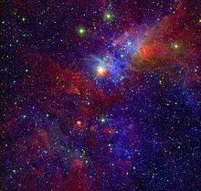
Magnetic Variable stars:
This is a star whose brightness as seen from Earth fluctuates.
This variation may be caused by a change in emitted light or by something partly blocking the light. The most common kinds of variability involve changes in brightness, but other types of variability also occur, in particular changes in the spectrum.

Slide 6
High-Energy Cosmic Rays Problems:
High-energy cosmic rays with energy exceeding 5 × 10^19 eV,Two problems are related.
The first problem :
concerns the direction of high energy particle motion. Such particles have too much momentum and the cosmic magnetic fields cannot twist their trajectories. It is thus expected that The projection of the particle motion of high energy on the sky arch should be grouped around any points that indicate these particles Sources. But it turned out that the directions of high energy particle arrival were almost evenly distributed over the sky sphere.
Second problem:
in the universe there is a microwave relic backdrop whereby particles of high energy lose part of their energy as they interact. In 1966 Greisen, Zatsepin and Kuzmin have theoretically calculated the limit value of the energy of cosmic rays emitted from distant sources. According to calculations, the energy loss is so great that the energy of the particles should not exceed 5 × 10^19 eV. This estimate assumed that particles of high energy were located farther than 50 million Parsec. Despite such a solid argument, the Japanese detector AGASA Has identified several tens of particles whose energy exceeds the theoretical limit, and in some cases the energy is 3 × 10^20 eV.
To explain this, many radical models have been proposed: 10^-35 seconds after the big explosion Presence of relic supernova particles; Breaking the Law of Speed Assemblies in the Special Theory of Lorentz-Symmetry, or Relativity, and etc.

Slide 7
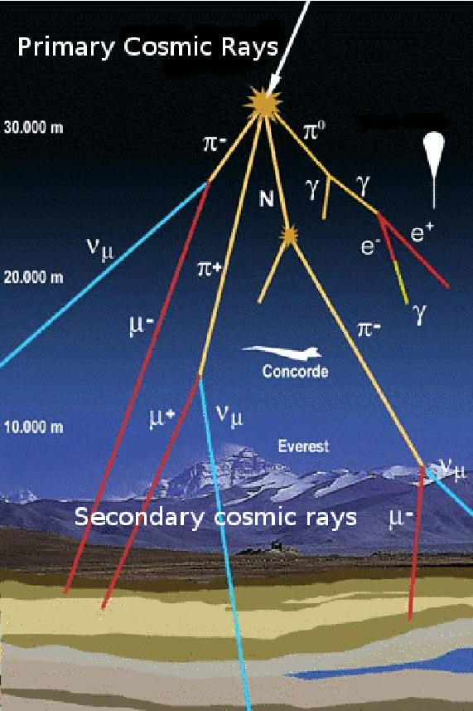
Cosmic rays:
As the Earth invades the atmosphere, cosmic rays cause the appearance of "wide atmospheric shower" These shower arise because of the interaction of the atmospheric particle beam with the nuclei of the atoms. First Interaction results are secondary particles(photons,leptopns and hadrons such as electrons, positrons,muons and pions), which in turn interact with air atoms to form new particles. So there is a cascading multiplication of particles. As a result, up to millions of small particles of "wide atmospheric dust" cover tens of thousands of square meters of Earth.
Up to 3 × 10^17 eV of energy per million square kilometers of the Earth's surface are emitted per year. The particles are distributed by energy so that as their energy increases, their number drops sharply.

Slide 8
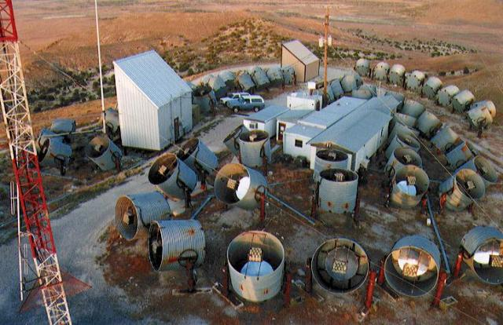
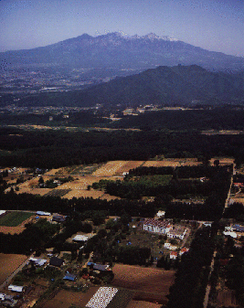
The Fly’s Eye
Detection:
The Fly’s Eye
The detector observes the formation of cascades in the atmosphere.can see this formation 15 kilometers far from the earth's surface. For it „ air shower “seems like a sphere that radiates ultraviolet light and moving with speed of light towards the Earth
AGASA
Located in the town of Akeno (Japan), it covers an area of 100 km² and consists of 111 surface detectors and 27 muon detectors. Array experiments such as this one are used to detect air shower particles.
AGASA

Slide 9
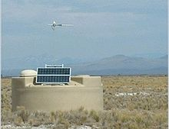
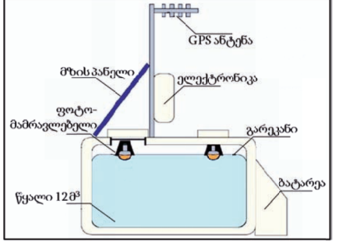
Pierre Auger Observatory:
Auger is Located in Argentina.It was designed to detect ultra high energy cosmic rays.has created a detection area of 3,000 km² .consist of water-Cherenkov detectors and fluorescence telescopes, covering the area of 10,370 km² (3.3 times larger than Auger ).There is 1600 Cherenkov’s detector ,each of them contains 12 T Water tanks where is 3 photomultiplier tubes to detect the Cherenkov radiation produced by high-energy particles passing through water in the tank. Distance between this tanks is 1.5 km.

Slide 10
Cosmic Neutrinos:
Composition -elemntary particle
Statistics -Fermionic
Interactions -Weak and gravitation
Types -electron neutrino, muon neutrino and tau neutrino
Electric Charge -0
Spin- 1/2

Slide 11
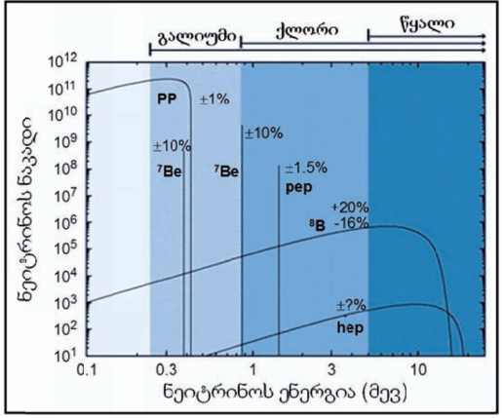
Neutirno:
The logarithmic scale shows the spectre of solar neutrinos.
neutrino flow change interval is large, varying from 10 to 10^12.

Slide 12
Neutrino:
For full research, it is necessary to register particles that interact weakly with the electromagnetic fields and matter in space. Such a particle is neutrino, for example.
the neutrino is so named because it is electrically neutral and because its rest mass is so small (-ino) that it was long thought to be zero.
the weak force has a vary short range, gravitational interaction is extremaly weak, and neutrinos do not participate in the strong interaction. Thus, neutrinos typically pass through normal matter unimpeded and undetected.
Large number of Neutrinos appeared during the Big Bang, and just 2 seconds after the expansion of the universe they stopped interacting with other matter. As a result, a microwave relic background would have to be created, similar to a neutron relic background whose temperature should currently be 1.7 k.
neutrinos born from thermonuclear combustion of stars are more real. The sun emits neutrinos of sufficiently high energy that, in spite of the very slight probability of their interaction with the substance of the experimental device, it is possible to accumulate reliable statistical material.

Slide 13
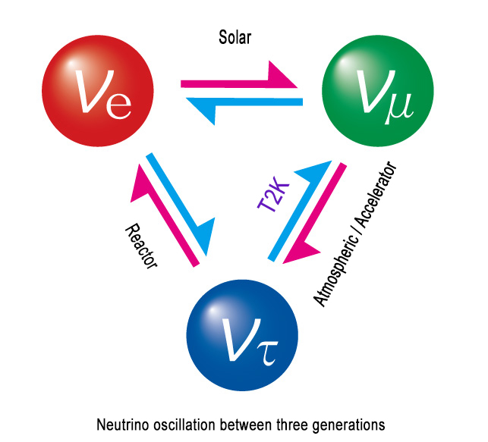
Neutrino oscillations:
About 30 years ago, the flow of neutrinos from the sun to the earth was first measured. This stream was three times less than expected in the standard solar model.The obtained results confirm the neutrinos deficiency. This deficit is explained by the oscillations of neutrinos that these particles experience from sun-earth gliding .
Neutrino oscillations have been found in nature. The neutrino may oscillate to become a larger muon neutrino and a muon neutrino can become a tau neutrino.(neutrinos are always born in pairs with electrons, muons, or tau particles. The names of these particles are called neutrinos species). If different types of neutrinos have masses that are non-zero,they can be transformed into one another. To make these transitions, in Lagrangian we must write a member describing this transition as this member can only be massive. his is how it became necessary to introduce neutrino mass.On the way from sun to earth, some of them are converted to muon or tau neutrino, which reduces the intensity of the electron neutrino flow. Experimentally, only electronic neutrino appears and therefore the observed neutrino deficiency in the observed stream.

Slide 14

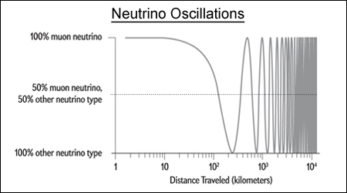
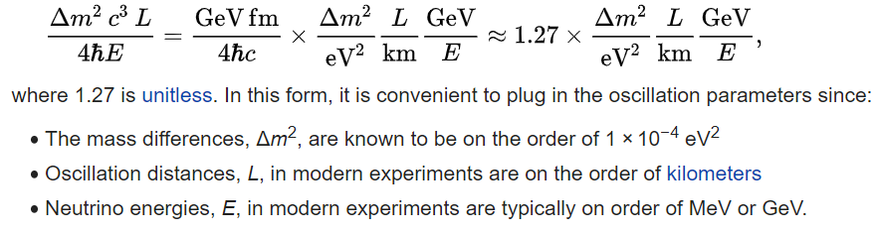

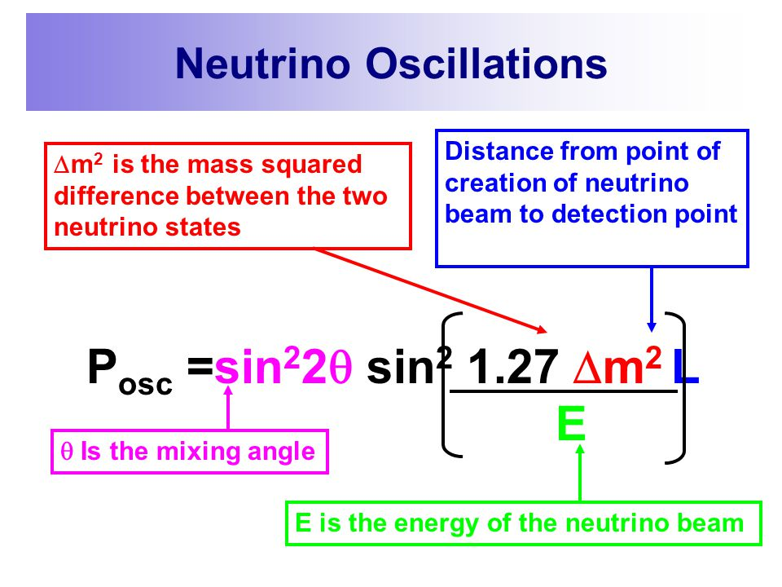
using SI units and the convention introduced above:
The probability formula for two-flavor oscillation:
Neutrinos have a unique property in that as they travel some distance at near the speed of light they transform themselves into other neutrino flavors. 100% of the particles leave Fermilab as a pure beam of muon neutrinos. After about 100 kilometers, 50% of the neutrinos will have transformed themselves into tau neutrinos. At about 250 kilometers, most of the neutrinos will now be the tau type, with just a small percentage the electron type.

Slide 15

Detection:
Solar neutrino was first registered in 1967 by Raymond Davis and his staff . The 680-tonne detector, used 37Cl of organic liquid.More than 0.814 MeV, energy neutrino was captured by the 37Cl nucleus, producing a radioactive argon core - 37Ar. The quantity of 37Ar determines the flow of neutrinos in the device. Such a method is called radiochemical analysis.
Much more effective is a detector in which the tank is filled with liquid Gallium.because gallium can absorb neutrino with energy At a much wider interval(from 0.233 mV to 20 mV). p + p neutrinos produced during reactions are in this interval.

Slide 16
Detection:
At present, tanks filled with liquid gallium are used to capture solar neutrinos in experiments SAGE (Soviet-American Gallium Experiment) and GALLEX (Gallium Experiment). SAGE is located in Baksan Neutrition Observatory (Balkan, Russia). The detector uses liquid metallic Gallium (57 tons).
GALLEX is located in Grand Sauces National Lab (Italy) and contains 30 tons of gallium.
A more efficient electronic type for detecting solar neutrinos is the SNO (Sudbury Neutrino Observatory) Observatory. is located at a depth of 2070 m in Canada . The detector contains 1000 tonnes of extremely clean heavy water- D2O enclosed in a transparent, plastic vessel(12m-diameter ) .The vessel is surrounded by 7,000 tons of clear water, which protects the detector from background particles. it registers neutrinos with energy more than 5 megawatts. When neutrinos interact with the nucleus of D2, charged particles appear which are registered by detectors.(contains 9600 photomultiplier tubes that record the Cherenkov radiation generated by the interaction of neutrino with the D2O core)

Slide 17
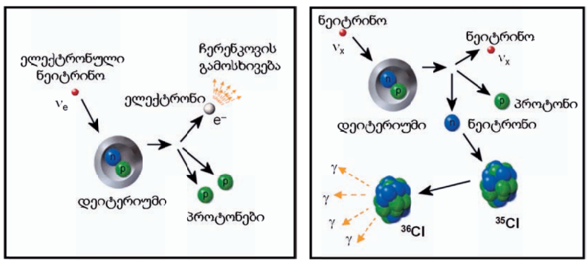
Detection:
The first type of reaction involves only the electronic neutrino since it can only decompose the deuterium that produced the electron. In this case, the detector records the fast electron Cherenkov radiation.
All three types of neutrinos can trigger the second type of reaction because a deuterium collapse gives rise to a similar type of neutrinos in collision. Therefore, the neutrino flux obtained by such a reaction would be predicted by a standard solar model. In order to register the second type of reaction, salt water is dissolved in heavy water. 35 Cl nucleus captures neuton and radiates photons , which are fixed by photomultiplier tubes.

Slide 18
Detection:
Now the solar neutrino is registered in the following experiments:
SNO (Canada)
BOREXINO,ICARUS,GNO (Italy)
SAGE (Russia)
CHLORINE (USA)
KAMIOKANDE (Japan)
Kamiokande registers not solar but atmospheric neutrinos. Atmospheric neutrinos are formed by the cosmic ray air molecules. Atmospheric neutrinos arise when they interact with air molecules in the cosmic rays. This is another difference compared to other experiments, which study electronic neutrinos

Slide 19
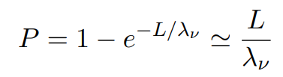


Detection:
Neutrino detectors must be generally placed deep underground, or in water, in order to escape the backgrounds caused by the inescapable rain of cosmic rays upon the atmosphere.
High energy neutrinos are detected by observing the Cherenkov radiation from secondary particles produced by neutrinos interacting inside large volumes of highly transparent ice or water, instrumented with a lattice of photomultiplier tubes.
consider an instrumented cubic volume of side L. Assume, for simplicity, that the neutrino direction is perpendicular to a side of the cube (for a realistic detector the exact geometry has to be taken into account as well as the arrival directions of the neutrinos). To a rst approximation, a neutrino incident on a side of area L^2 will be detected provided it interacts within the detector volume, i.e. within the instrumented distance L. That probability is :
ρ- the density of the ice/ water,
NA -Avogadro's number
σν -the neutrino-nucleon cross section.
where
A neutrino flux F crossing a detector with cross sectional area A≃L^2 facing the incident beam,will produce
A, P and F depend on the neutrino energy and N is obtained by a convolution over neutrino energy above the detector threshold.

Slide 20

Thank You For Your Attention

