Slide 1

AXION

Slide 2
History
Possible detection
Properties

Slide 3
Strong CP problem
As shown by Gerard 't Hooft, strong interactions of the standard model, QCD, possess a non-trivial vacuum structure that in principle permits violation of the combined symmetries of charge conjugation and parity, collectively known as CP. Together with effects generated by weak interactions, the effective periodic strong CP-violating term, Θ, appears as a Standard Model input – its value is not predicted by the theory, but must be measured. However, large CP-violating interactions originating from QCD would induce a large electric dipole moment (EDM) for the neutron.
One simple solution exists: If at least one of the quarks of the standard model is massless, CP-violation becomes unobservable.

Slide 4
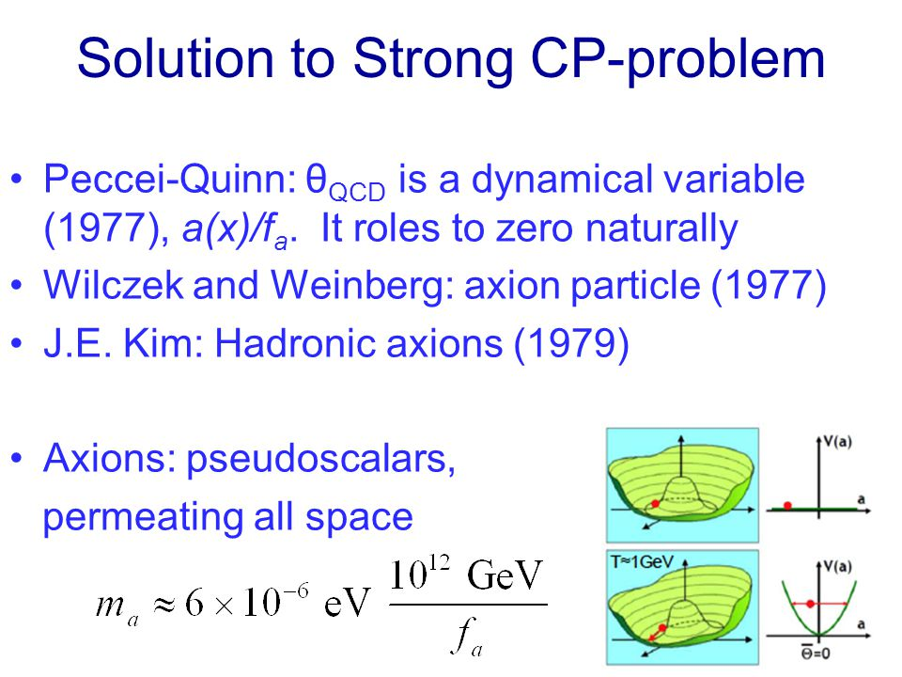

Slide 5
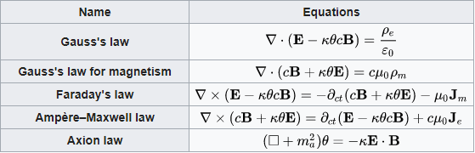

Maxwell's equations with axion modifications

Slide 6
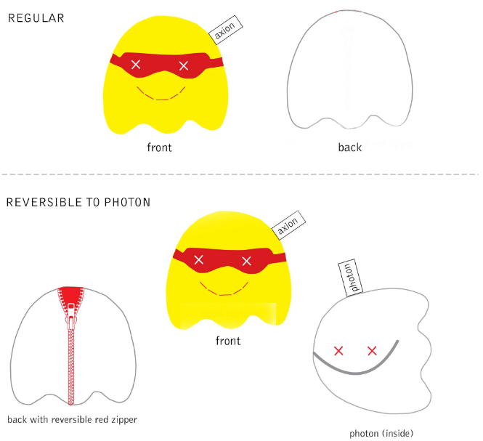

Slide 7
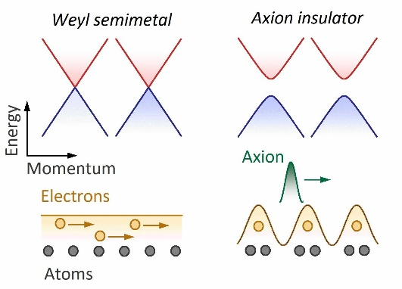
Topological insulator
A topological insulator is a material with non-trivial symmetry-protected topological order that behaves as an insulator in its interior but whose surface contains conducting states, meaning that electrons can only move along the surface of the material. However, having a conducting surface is not unique to topological insulators, since ordinary band insulators can also support conductive surface states. What is special about topological insulators is that their surface states are symmetry-protected by particle number conservation and time-reversal symmetry.

Slide 8
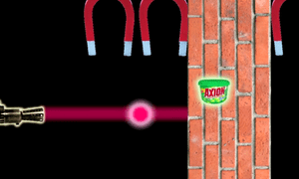
Experiments
Technique is so called "light shining through walls", where light passes through an intense magnetic field to convert photons into axions, that pass through metal. Experiments by BFRS and a team led by Rizzo ruled out an axion cause. GammeV saw no events, reported in a 2008 Physics Review Letter. ALPS-I conducted similar runs, setting new constraints in 2010; ALPS-II will run in 2019. OSQAR found no signal, limiting coupling and will continue.

Slide 9
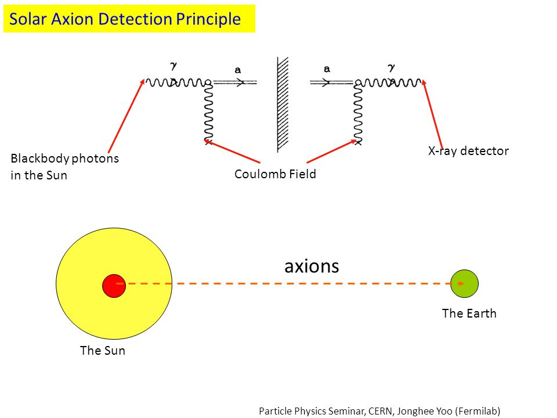
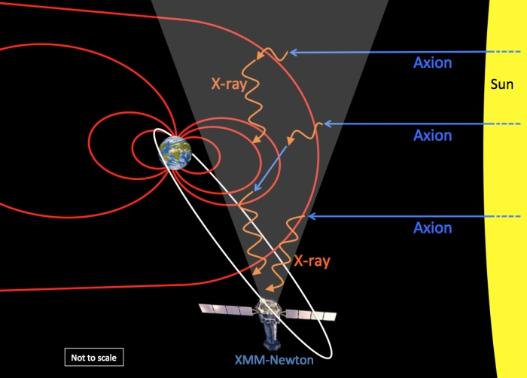
Several experiments search for astrophysical axions by the Primakoff effect, which converts axions to photons and vice versa in electromagnetic fields. Axions can be produced in the Sun's core when X-rays scatter in strong electric fields.

Slide 10
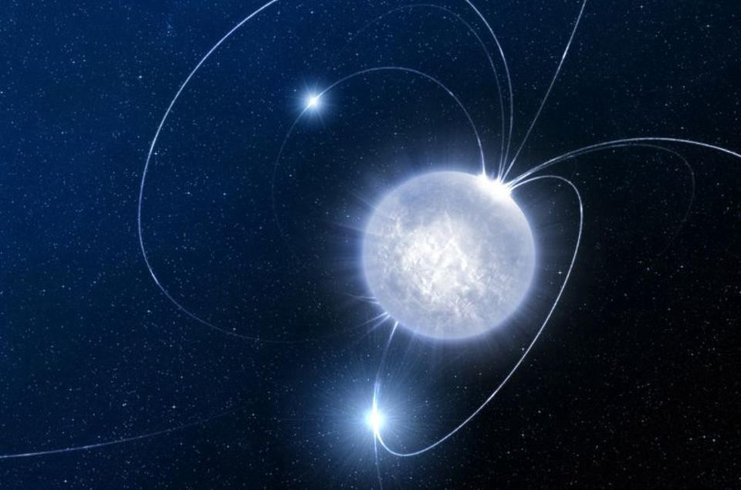
Axions may be produced within neutron stars, by nucleon-nucleon bremsstrahlung. The subsequent decay of axions to gamma rays allows constraints on the axion mass to be placed from observations of neutron stars in gamma-rays using the Fermi LAT. From an analysis of four neutron stars, Berenji et al. obtained a 95% confidence interval upper limit on the axion mass of 0.079 eV.

Slide 11
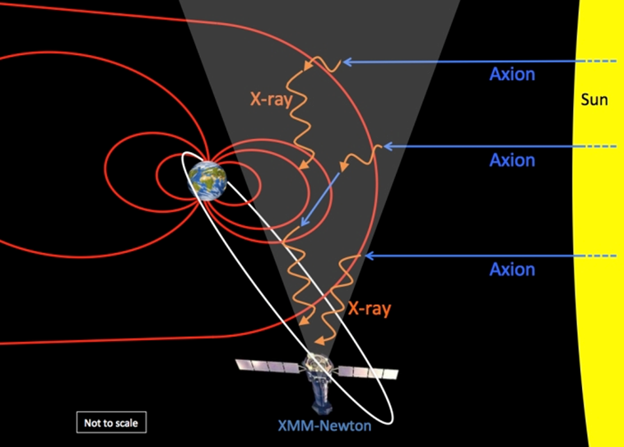
Possible detection
It was reported in 2014 that evidence for axions may have been detected as a seasonal variation in observed X-ray emission that would be expected from conversion in the Earth's magnetic field of axions streaming from the Sun. Studying 15 years of data by the European Space Agency's XMM-Newton observatory, a research group at Leicester University noticed a seasonal variation for which no conventional explanation could be found. One potential explanation for the variation, described as "plausible" by the senior author of the paper, is the known seasonal variation in visibility to XMM-Newton of the sunward magnetosphere in which X-rays may be produced by axions from the Sun's core.

Slide 12
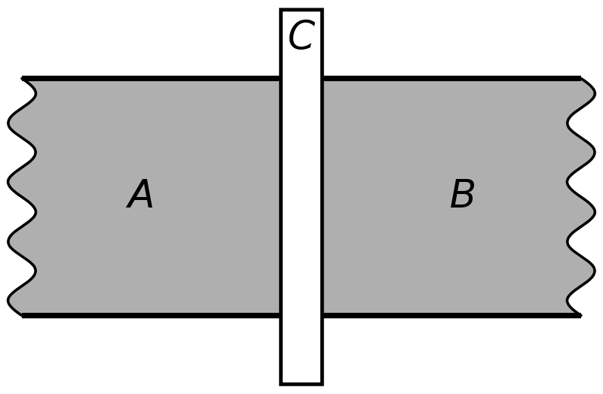
Josephson effect
The Josephson effect is the phenomenon of supercurrent, a current that flows indefinitely long without any voltage applied, across a device known as a Josephson junction (JJ), which consists of two or more superconductors coupled by a weak link. The weak link can consist of a thin insulating barrier (known as a superconductor–insulator–superconductor junction, or S-I-S), a short section of non-superconducting metal (S-N-S), or a physical constriction that weakens the superconductivity at the point of contact (S-s-S).
The Josephson effect is an example of a macroscopic quantum phenomenon.

Slide 13
Predictions
One theory of axions relevant to cosmology had predicted that they would have no electric charge, a very small mass in the range from 1 µeV/c² to 1 eV/c², and very low interaction cross-sections for strong and weak forces. Because of their properties, axions would interact only minimally with ordinary matter. Axions would also change to and from photons in magnetic fields.

Slide 14
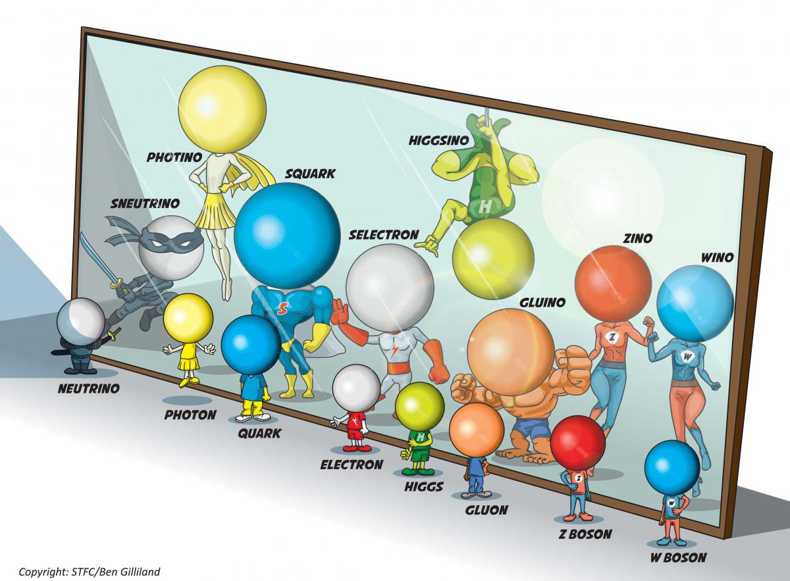
Supersymmetry
In supersymmetric theories the axion has both a scalar and a fermionic superpartner. The fermionic superpartner of the axion is called the axino, the scalar superpartner is called the saxion or dilaton. They are all bundled up in a chiral superfield.
The axino has been predicted to be the lightest supersymmetric particle in such a model. In part due to this property, it is considered a candidate for dark matter.

Slide 15
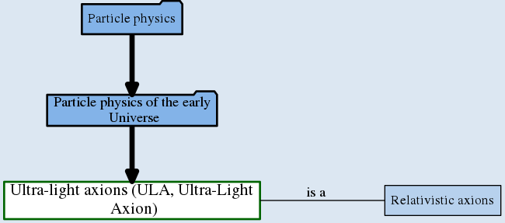
Cosmology
Inflation suggests that axions were created abundantly during the Big Bang
If axions exist, scatterings with other particles in the thermal bath of the early universe unavoidably produce a population of hot axions.
Ultralight axion (ULA) with m ~ 10⁻²² eV is a kind of scalar field dark matter which seems to solve the small scale problems of CDM.
Axions would also have stopped interaction with normal matter at a different moment than other more massive dark particles

Slide 16
THANKS

