Slide 1
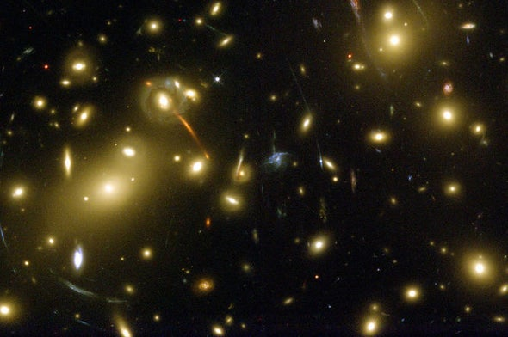
Dark Matter

Slide 2
Definition
Dark Matter is matter that we cannot see. It neither emits nor reflects any light. If we can’t see it, how do we know it exists? Scientists can measure dark matter indirectly by observing its gravitational effects in a variety of ways. Dark matter is one of the most fascinating mysteries in science.

Slide 3
Problems
The rotation of galaxies
The appearance of far away galaxies
The behavior of galaxy clusters
The total amount of observed matter in the universe

Slide 4
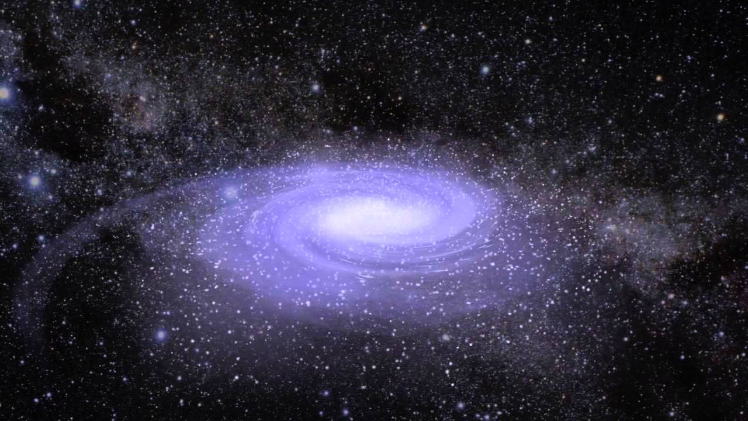
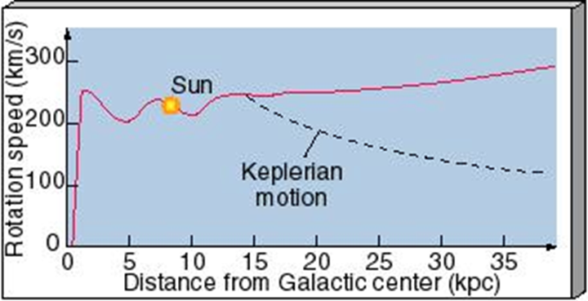
Galaxies Rotate
Galaxies are collections of billions of stars. Most of the light from a galaxy comes from its center. This indicated that most of the galaxies stars and most of its mass is concentrated at its center. Under this scenario, we should expect the stars in the outer part of the galaxy to rotate about the center, and this is just what we observe. But outer stars do not rotate correctly! If gravity causes galaxies to rotate, as we assume it does, then outer stars should behave much like the planets of our solar system. Inner planets rotate faster and outer planets rotate slower. This is called Keplerian motion. In galaxies, however, both inner and outer stars rotate at about the same speed

Slide 5
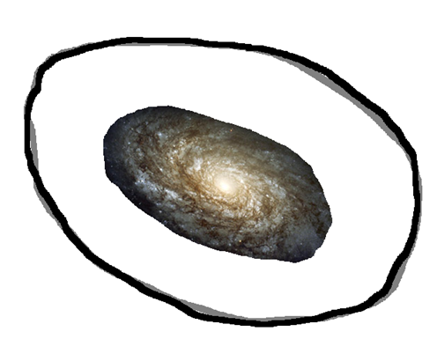
Idea
In order for gravity to cause this type of rotation, each galaxy must be surrounded by a super-massive halo of matter. No such halos, however, can be seen. So we conclude that they are made of dark matter

Slide 6
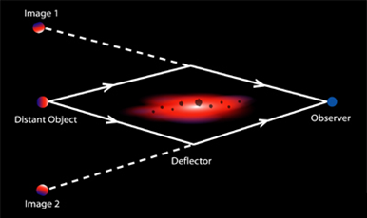
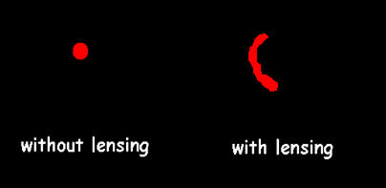
Lensing by dark matter
What could be strong enough to crush a galaxy? It turns out that just the images of the galaxies were stretched out. The culprit was gravity. The light from these distant galaxies was attracted to mass between the galaxy and the Earth. This attraction bent the light and caused the galaxies to look distorted, as if they were being seen through a crooked lens. Sometimes galaxies are lensed by other galaxies. Other times they were lensed by invisible objects – dark matter. By measuring the distortion of the galaxies, scientists were able to “weigh” the dark matter.

Slide 7
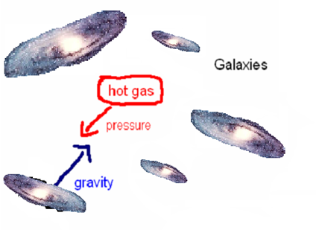
Galaxy Clusters
Nearly all the visible matter in the universe is found in galaxies which are distributed throughout space. Galaxies are often found in groups called clusters. Radio astronomers have found hot gas in the space between galaxies in a cluster. This gas produces a pressure that pushes the galaxies apart. The galaxies’ mutual gravitational attraction causes them to cling together. The heavier the galaxies, the stronger the gravitational attraction.

Slide 8

Simple way to mass a galaxy
Mass of galaxy = number of stars x average mass of star
It turns out that galaxies do not have enough visible mass to stay grouped in clusters. The extra mass they need must come from dark matter.

Slide 9
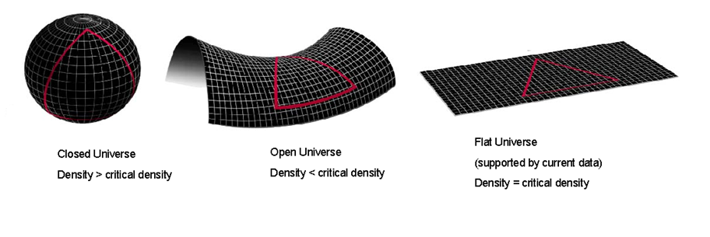
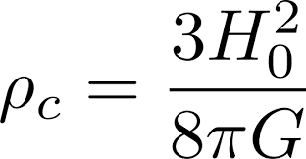
Curvature
According to general relativity, mass bends space. Cosmologists have calculated the density necessary for the universe to be flat – the critical density. If the universe had a lower average density, it would have negative curvature and an open shape. If the universe had a greater density it would have positive curvature and a closed shape

Slide 10
Hot or Cold
If the particles that make up dark matter are small, then dark matter is said to be hot. If the particles are large, then it is called cold. Theories with cold dark matter have more success explaining how galaxies formed. Theories with hot dark matter do a better job explaining the origins of clusters and superclusters. Recent experiments suggest that dark matter is cold, but some researchers believe that the universe contains a mix of both hot and cold dark matter

Slide 11

Dark Matter Particle
Many exotic particles have been proposed as candidates for dark matter including massive neutrinos, weakly interacting massive particles (WIMP’s), massive compact halo objects (MACHO’s), black holes, and brown dwarfs. It is unlikely that one explanation will satisfy everyone. When looking at galaxy rotation, it appears that dark matter occurs in halos around galaxies. But when looking at gravitational lensing and clusters, most of the dark matter appears to be smeared out in between galaxies

Slide 12
Thank you

