Slide 1
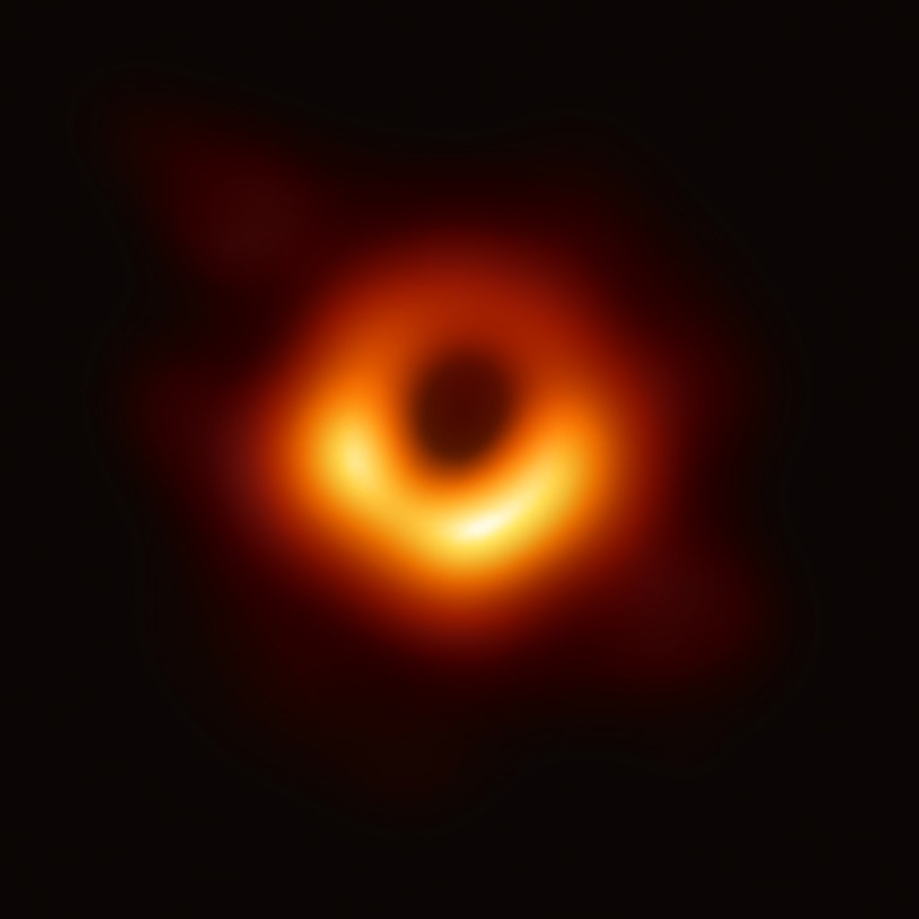
Black Hole Thermodynamics

Slide 2

The horizon area theorem
[Stephen Hawking]
1970: Stephen Hawking uses the theory of general relativity to derive the so-called
Horizon area theorem
The total horizon area in a closed system containing black holes never decreases. It can only increase or stay the same

Slide 3
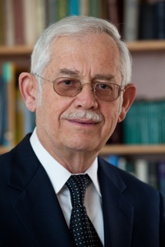
Analogy between the area theorem and the 2nd law of thermodynamic
[Jacob Beckenstein]
Shortly after Stephen Hawking Formulated the area theorem, Jacob Beckenstein, at the time a graduate student at Princeton, noticed the analogy between the area theorem and the 2nd law of thermodynamics: The total area of a closed system never decreases.
Entropy: logarithm of the number of ways you can relocate the atoms and molecules of a system without changing the overall properties of the system.

Slide 4
Horizon is a null hypersurface
No one can come out of the horizon.
rH =2GM
BH mass always increases classically.
Horizon area never decreases
like entropy in thermodynamics.
d A > 0
=

Slide 5
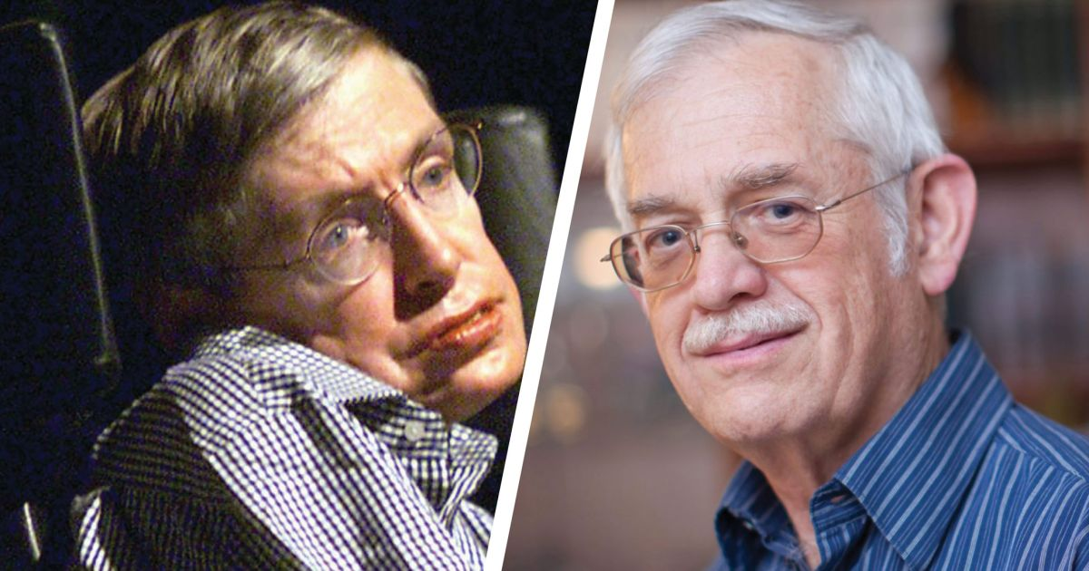
Hawking-Beckenstein debate (1972)
Hawking: the analogy between the area theorem and the 2nd law of thermodynamics is just a matter of coincidence.
Beckenstein: I am not convinced. Nowhere in nature the 2nd law of thermodynamics is violated. Why black holes would be an exception? I believe that the area of black holes is acutally a manifestation of their entropy.
Wheeler (Beckenstein’s thesis advisor) to Beckenstein: Your idea is just so crazy that it might actually be true..
Hawking: if a BH has entropy, it must have a temperature, and if it has a temperature it must radiate like a blackbody. But if nothing can escape from a BH, how can it radiate?

Slide 6
1974: end of the debate and discovery of the Hawking radiation
1974: Hawking admits that Beckenstein was right: Black Holes have entropy, which is proportional to their area. However, this no longer constitutes a problem, because Hawking discovers a mechanism by which black holes can radiate. This mechanism involves quantum-mechanical processes near the BH horizon. According to quantum mechanics, vacuum is no longer an “empty” state as in classical physics. Instead, it is a place where “virtual particles” are constantly created and destroyed. The creation of a couple of particle-antiparticle pair of energy is allowed in quantum mechanics as long as their lifetime satisfies the Heisenberg uncertainty principle.

Slide 7
Analogy with Thermodynamics
Equilibrium Thermodynamics | Black Hole
0th law T=const. | 0th law κ=const.
1st law dE = T dS | 1st law dM =κ/(8πG) dA
2nd law dS > 0 | 2nd law dA > 0
Classical correspondence

Slide 8
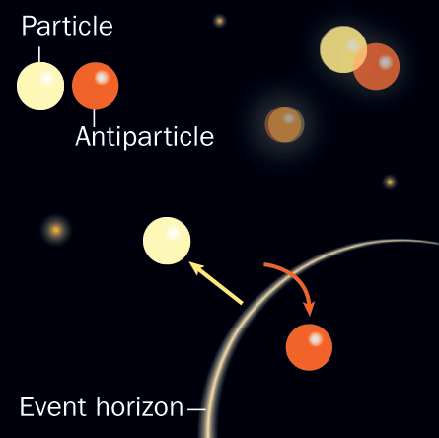

Physical picture of Hawking radiation
virtual pair creation of particles
real pair creation
Hawking radiation
thermal spectrum with T

Slide 9


Hawking radiation from black hole
In 1974 Hawking found that black hole radiates.
This really gave sense to the analogy with thermodynamics.
Hawking temperature:
Entropy of BH:
They are quantum effects!

Slide 10
Hawking radiation reduces BH mass.
Area decreases and 2nd law is violated.
Generalized 2nd law
Stot = SBH + Srad
d Stot > 0
=
Microscopic (statistical ) meaning of BH entropy?
Thermal Hawking radiation contradicts with the unitary
evolution of quantum states. → information paradox
(2) Microscopic understanding of BH entropy?
needs quantum nature of space-time?

Slide 11
Basic idea to understand BH entropy in strings
Strings: both of matters and space-time (graviton) are
excitations of strings
At strong coupling, string with mass M
becomes BH when its Schwarzschild radius
equals the string length.
string
(2GM ~ ls)
rH =2GM
S = kB log N(M) =kB ls M/ h
~ kB (GM) / (h G) =SBH
N(M) = exp (ls M/ h)
2

Slide 12

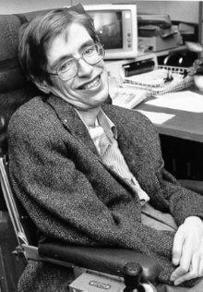
Hawking’s latest discovery (2004)
information is not completely lost when falling into a BH into a black hole
If you jump into a BH, your mass and energy will be returned to our Universe, but in a mangled form, which contains information about what you were like, but in an unrecognizable state

Slide 13
Thank you

