Slide 1
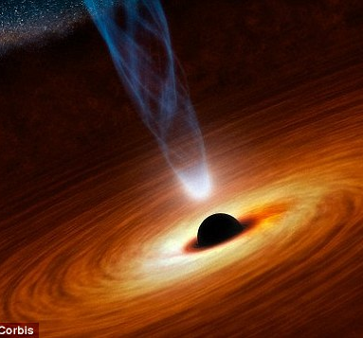

Active
Galactic
Nuclei
Department of Physics, Faculty of Exact and Natural Sciences, Tbilisi State University, Tbilisi, Georgia
Teo Gotsiridze

Slide 2
Contents
CLASSIFICATION SCHEME
The unified scheme of AGNs
Regions
Radio-Quiet and Radio-loud Nuclei
Gravitational Lensing of Quasars
Schwarzschild and kerr metric

Slide 3
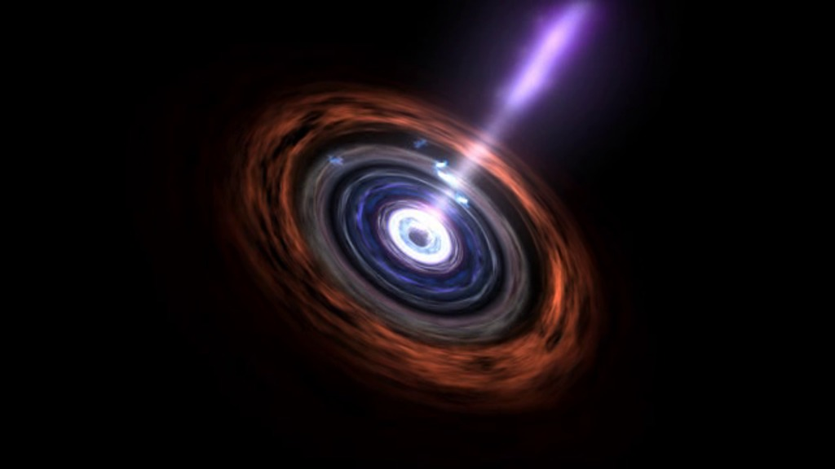
Active galaxies are among the most exciting and challenging phenomena in modern astrophysics. They are the most powerful and luminous objects in the Universe.
Active galactic nuclei (AGNs) are powered by supermassive black holes and that accretion of gas into this central black hole is at the origin of their incredible luminosity. The accretion flow is thought to be the source of the X-ray, ultraviolet, and optical continuum emission. This emission ionizes the gas located in both the broad and narrowline regions and may also be the source of winds and jets.

Slide 4
CLASSIFICATION SCHEME
Typically, scientists divide AGN into two categories
radio-loud nuclei (AGNs that have radio emissions produced by both the accretion disk and the jets.)
(Blazars,radio galaxies)
radio-quiet nuclei (AGNs are simpler, in that any jet or jet-related emission are negligible.)they are powered by accretion on to a supermassive black hole. (Seyfert galaxy)
With the discovery of active galaxies, which started with the findings of Carl Seyfert during the 1940s, astronomers also discovered how broad the diversity among these objects is. so they built a classification scheme.
Seyfert galaxy
Quasars
Radio galaxies
Blazars

Slide 5
An unified scheme in which AGNs share certain fundamental ingredients:
A central supermassive black hole
An accretion disk high velocity gas, usually referred to as the broad-line region​
Lower velocity gas in the narrow line region, ​
An obscuring torus of gas and dust, hiding the broad-line region from some directions​
A relativistic jet, typically formed within 100 AU of the black hole and extending outward for tens of kpc and, in some cases, as much as one Mpc.

Slide 6
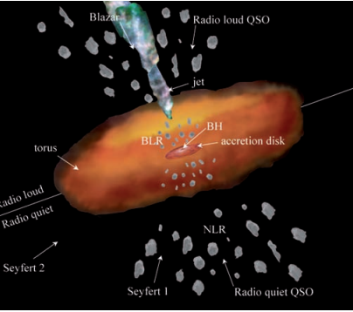
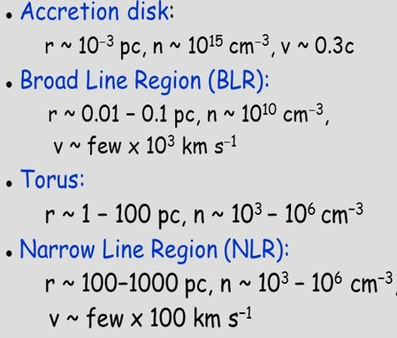
The unified scheme of AGNs
The central black hole and the accretion disk are surrounded by a thick torus of dust and gas.
The broad line region is located within this torus and is composed of small clouds of gas orbiting the central region and producing the broad emission lines.
Farther out is the narrow line region, characterized by slower orbiting clouds producing the narrow emission lines. The orientation of the observer relative to the torus axis determines the classification of the source.
The presence or absence of radio jets determines whether the source is radio loud or radio quiet.

Slide 7
Regions
Broad line region (BLR)
Above the accrettion disk
Heavy ionized clouds( by the ultraviolet and X-ray emission of the central engine.This highly ionized gas produces the broad emission lines)
temperatures in the range 15,000 to 20,000 K.
High density (10^10 cm^-3 gas clouds)
Movement – 1000-10 000 km/s (In order to broaden these lines to the observed extent, the gas must have large velocities)
Narrow line region (NLR)
Beyond the BLR
Heavy ionized clouds
low density (10^4 cm^-3 gas clouds)
Emmissionliness in the spectrum less intensely dispread
Slower movement 100 km/s

Slide 8
Supermassive black hole
The principal energy provider for the AGN luminosity is gravitational energy, and the mediator of this is a supermassive (i.e. 106 − 109 M ) black hole located at the very centre of the host galaxy. The black hole works like an enormous engine, converting potential energy of infalling material into kinetic and electromagnetic energy. This central engine is a complex mixture of intense photon field, energetic charged particles and, potentially, pair production. These numerous high-energy processes combine and generate the observed hard X-ray (in the 2 − 20 keV range)

Slide 9
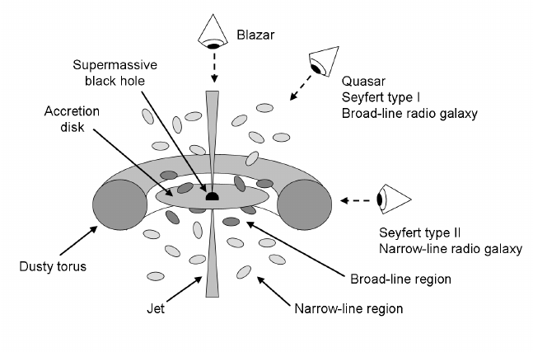
The geometry of the AGN assumed in unified models where the classification of the central light source mainly depends on the viewing angle. The approximate viewing angles of certain types of AGN have been indicated. which member you are observing depends on the angle between the observer and the object.

Slide 10
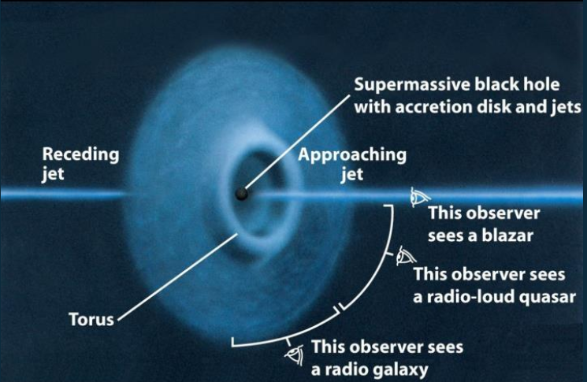

Slide 11
Seyfert galaxy
Radio-Quiet Nuclei
“Seyfert galaxies” are spiral- or irregular galaxies with very luminous galactic nucleus (they can also emit gamma-rays)They are AGN, as Quasars, but with a less massive black hole at the center .they are a type of radio-quiet AGN that are known for their emission lines, and are subdivided into two categories
Type 1 Seyfert (have both narrow(with a width of several hundred km/s) and broadened ( with widths up to 10^4 km/s) optical emissions lines, which imply the existence of clouds of high density gas, as well as gas velocities of between 1000 – 5000 km/s near the nucleus.)
Type 2 Seyfert ( have narrow emissions lines only. These narrow lines are caused by low density gas clouds that are at greater distances from the nucleus, and gas velocities of about 500 to 1000 km/s.)
Seyferts have only moderate radio emission (~10^40erg/s) but strong x-ray emission (> 10^42 erg/s)
As well as Seyferts, other sub classes of radio-quiet galaxies include radio-quiet quasars and LINERs( the lowest-luminosity AGN in existence, and it is often wondered if they are in fact powered by accretion on to a supermassive black hole)

Slide 12
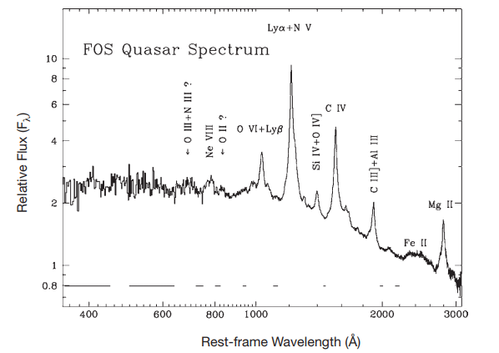
Radio-loud Nuclei
Radio galaxies
are types of AGNs that are very luminous at radio wavelength,.
Elliptical galaxies .
luminosities up to 10³⁹ W.
they are are strong emitters of radio emission. The radio emission is due to the synchotronic proceses .
(due tofast moving electrons that spiral in magneticfields, producing Synchotronic emission)
they have big jets And not obvious BH.
The largest radio galaxies have lobes or plumes extending to megaparsec scales.the jets feed the lobes, the pressure of the lobes increases, and the lobes expand. How fast they expand depends on the density and pressure of the external medium
Quasars
Quasars are the most luminous AGN. The power radiated by quasars is enormous: the most powerful quasars have luminosities thousands of times greater than a galaxy such as the milky way .typical quasar luminosity is about 10^39 watts. (The Sun’s luminosity is about 4 × 10^26watts.)
The spectra of quasars are similar to Seyferts except that the narrow emission lines are weaker relative to broad lines as seen in Seyferts.
Radio-loud quasars are quasars with powerful jets that are strong sources of radio-wavelength emission. These make up about 10% of the overall quasar population.
Radio-quiet quasars are those quasars lacking powerful jets, with relatively weaker radio emission than the radio-loud population. The majority of quasars (about 90%) are radio-quiet.
Red quasars are quasars with optical colors that are redder than normal quasars
optically violent variable (OVV) quasars are radio-loud quasars in which the jet is directed toward the observer. Relativistic beaming of the jet emission results in strong and rapid variability of the quasar brightness

Slide 13
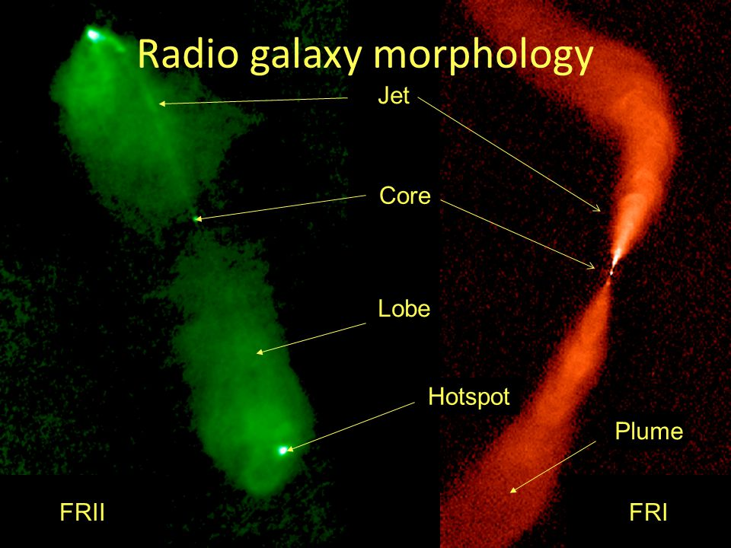

Slide 14
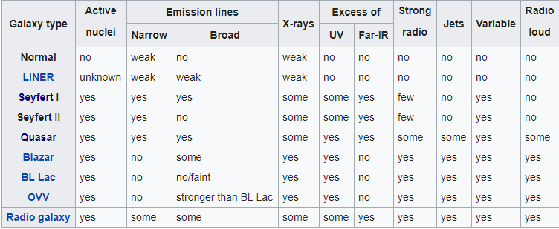

Slide 15
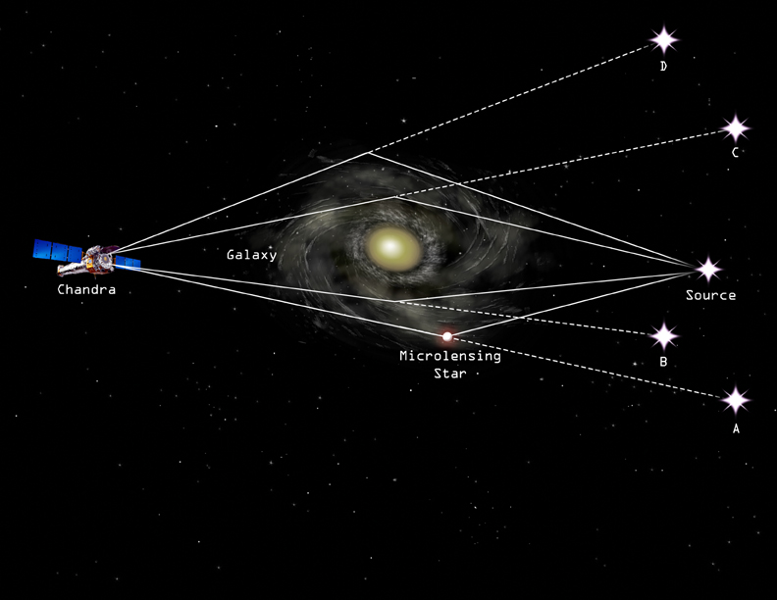
Gravitational Lensing of Quasars
If a quasar lies directly behind a massive galaxy, it can be gravitationally lensed and produce multiple images.
In general relativity, masses curve space and bend the trajectory of photons.

Slide 16

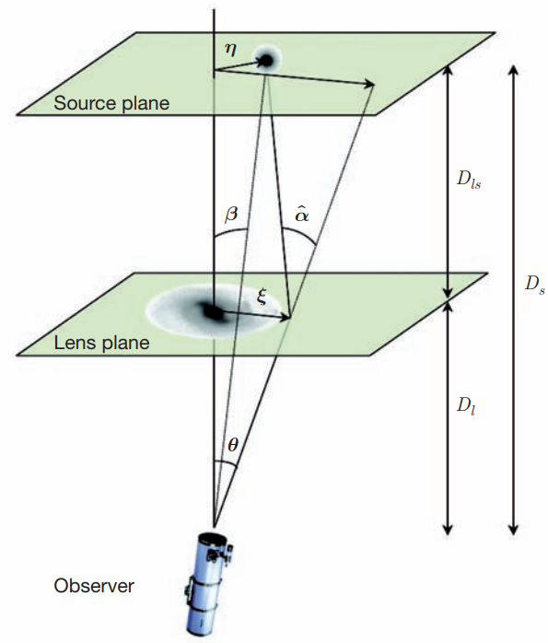
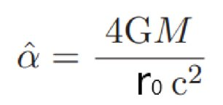

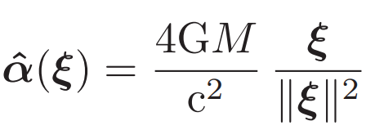
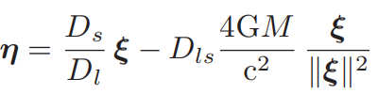

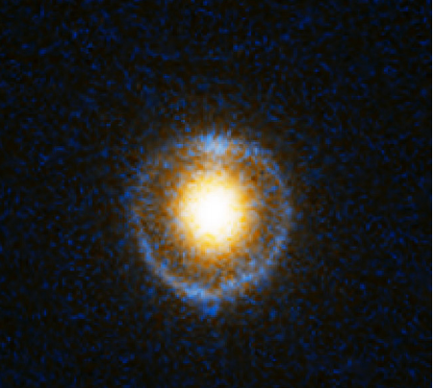
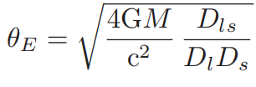
the lens equation:
where α is the deflection angle.
The deflection of light is due to the space-time curvature induced by the mass Of the lens.
In other words, the metric tensor and the deflection angle α, are determined by solving the Einstein
field equations. The first exact solution of the Einstein field equations (besides the trivial flat space
solution) was given by Karl Schwarzschild . a very good approximation of the deflection angle is
given by
deflection angle is small in most relevant astrophysical situations. Hence r0 can be approximated by
Then two-dimensional deflection angle satisfying the lens equation is:
we use this in the lens equation we get :
,
where we have defined the Einstein angle .
A ring-shaped image of radius θE is formed when the lens, the source and the observer are
aligned (i.e. β = 0). This ring is called an Einstein ring.
(4 image system is an Einstein cross)

Slide 17
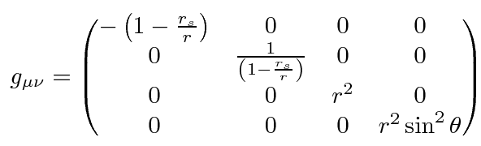


Schwarzschild solved the Einstein equations under the assumption of spherical symmetry in 1915.
(For a time-steady nonrotating black holes)
The metric tensor in Schwarzschild :
space-time interval in spherical coordinates in the Schwarzschild solution :
where T is the proper time (time measured by a clock moving with the particle) in seconds, t is the coordinate time (measured by a stationary clock at infinity) in seconds, r is the radial coordinate in meters, θ is the polar angle, φ is the azimuthal angle, and is the Schwarzschild radius (in meters) of the massive body, which is related to its mass M.
This goes to the normal flat Minkowski space-time interval (in spherical coordinates) for or for zero M
Schwarzschild solution is only valid outside the object. For black holes, the Schwarzschild radius is the horizon inside of which nothing can escape the black hole.

Slide 18
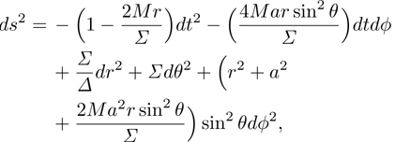
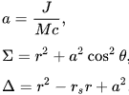
Kerr Metric
When black hole rotates metric is no longer spherically symmetric.The Kerr metric describes the geometry of empty spacetime around a rotating uncharged axially symmetric event horizon.
Kerr spacetime depends on two parameters: M-mass and a-angular momentum per unit mass. When a=0 kerr spacetime reverts to schwarzschild spacetime if we remove mass too only minkowski spacetime remains.
Where:

Slide 19
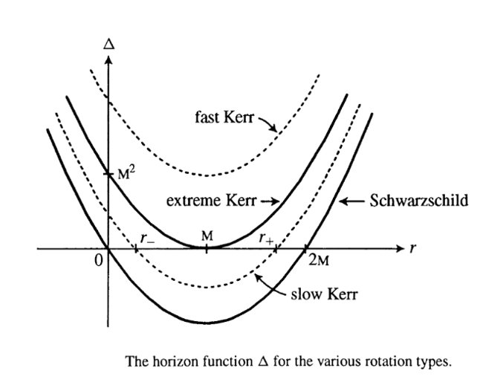
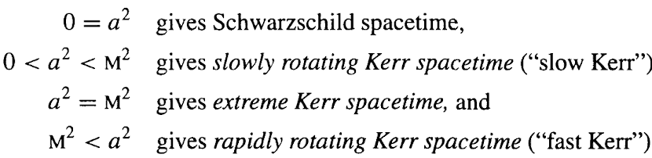
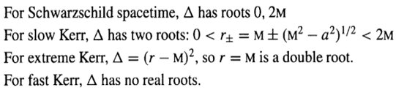
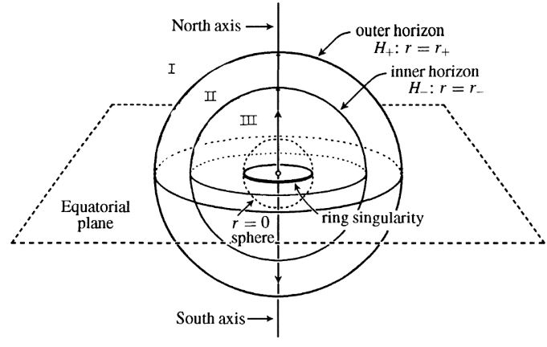
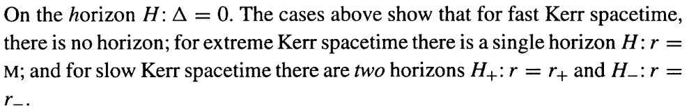
metric fails when:

Slide 20
Bibliography
Julian H Krolik-Active Galactic Nuclei: From the Central Black Hole to the Galactic Environment
Derek J. Raine, Edwin George Thomas-Black Holes: An Introduction
Barrett O'Neill-The Geometry of Kerr Black Holes
Alexander Eigenbrod-GRAVITATIONAL LENSING OF QUASARS
https://www.universetoday.com/30719/active-galactic-nuclei/

Slide 21
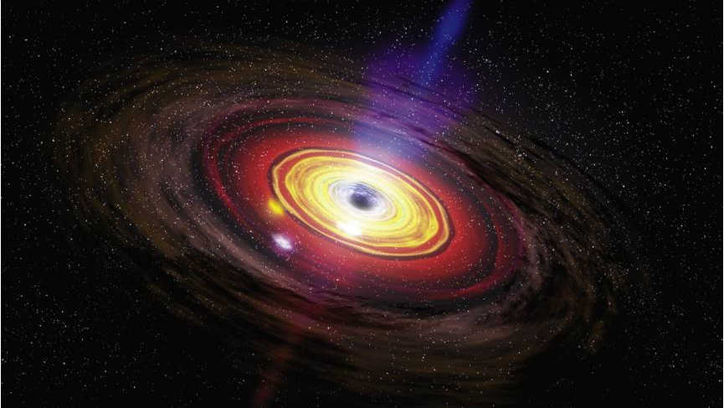
Thank You For Your Attention

